Slide 1
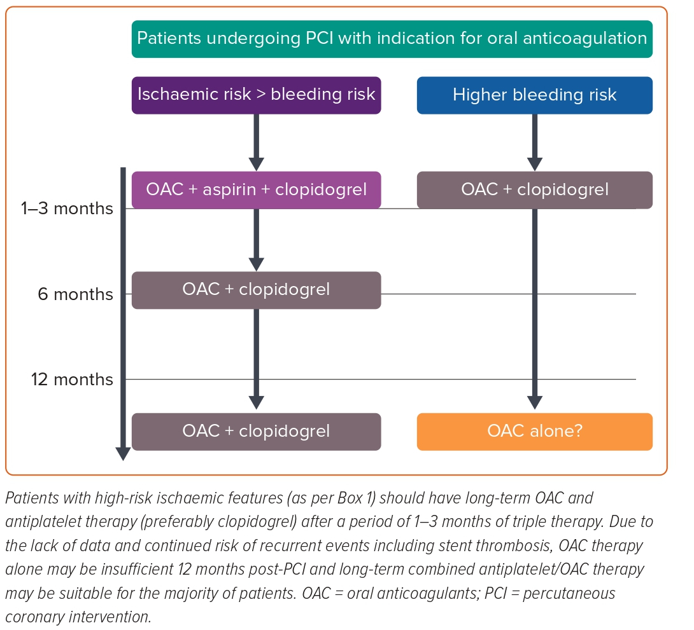
Abdulrahman B, Jabbour RJ, Curzen N
Figure 1: Antithrombotic Regimen for Patients Undergoing Percutaneous Coronary Intervention with Indication for Oral Anticoagulation
Citation: Interventional Cardiology 2023;18:e22.
https://doi.org/10.15420/icr.2022.40

