Slide 1
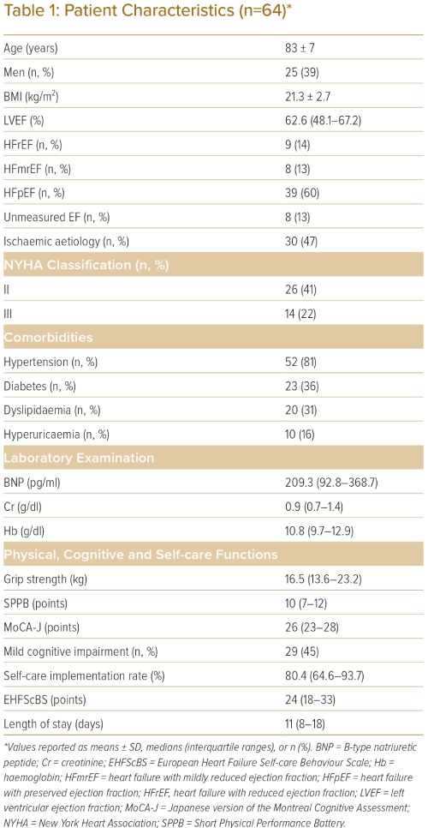
Soma M, Noda T, Ueno K, Takahashi W, Matsunaga A, Kamiya K
Patient Characteristics (n=64)*
Citation: Journal of Asian Pacific Society of Cardiology 2023;2:e21.
https://doi.org/10.15420/japsc.2022.23

