Slide 1
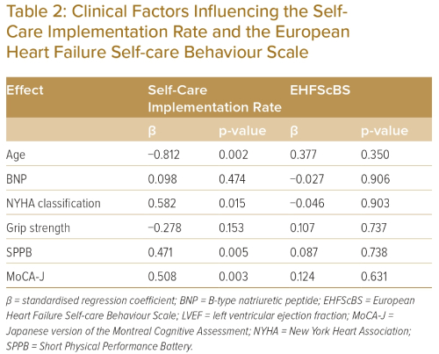
Soma M, Noda T, Ueno K, Takahashi W, Matsunaga A, Kamiya K
Clinical Factors Influencing the SelfCare Implementation Rate and the European Heart Failure Self-care Behaviour Scale
Citation: Journal of Asian Pacific Society of Cardiology 2023;2:e21.
https://doi.org/10.15420/japsc.2022.23

