Slide 1
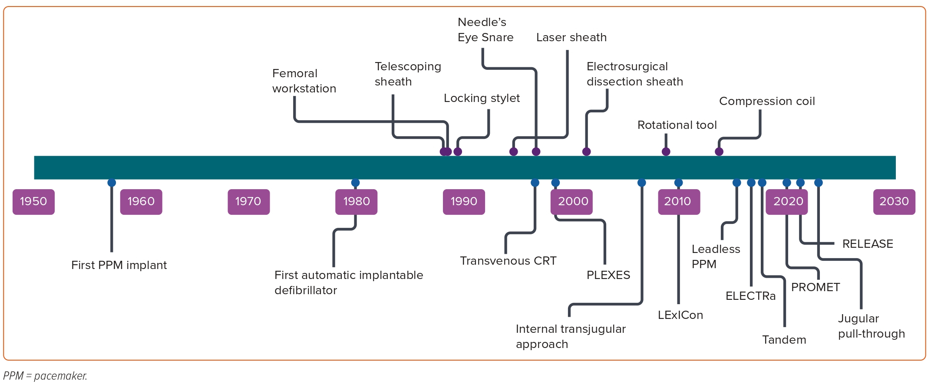
Akhtar Z, Sohal M, Sheppard MN, Gallagher MM
Figure 1: Timeline of Key Tools, Techniques and Studies in Transvenous Lead Extraction
Citation: European Cardiology Review 2023;18:e44.
https://doi.org/10.15420/ecr.2023.06

