Slide 1
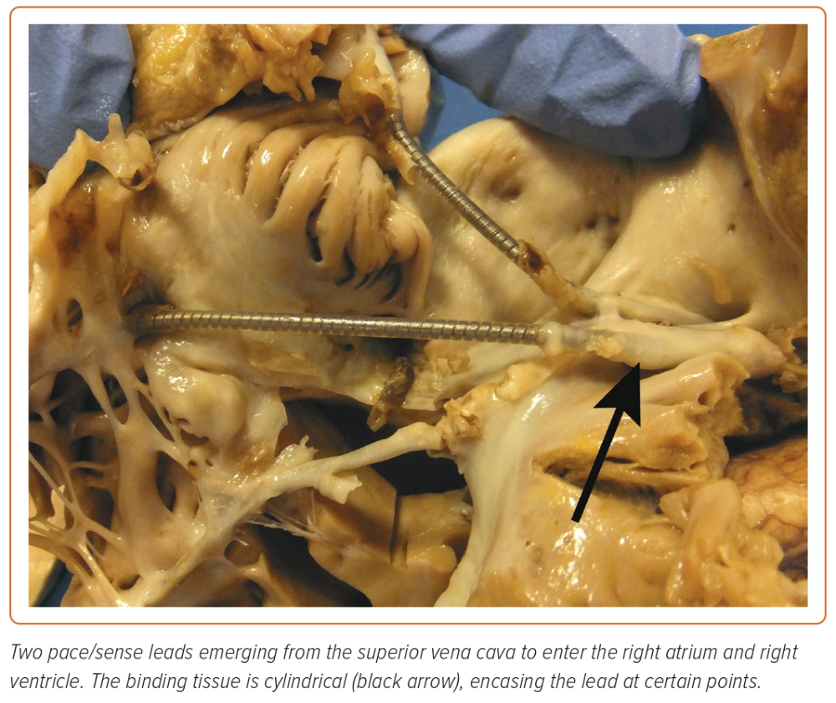
Akhtar Z, Sohal M, Sheppard MN, Gallagher MM
Figure 5: Cadaveric Image Demonstrating the Binding Tissue Around Leads
Citation: European Cardiology Review 2023;18:e44.
https://doi.org/10.15420/ecr.2023.06

