Slide 1
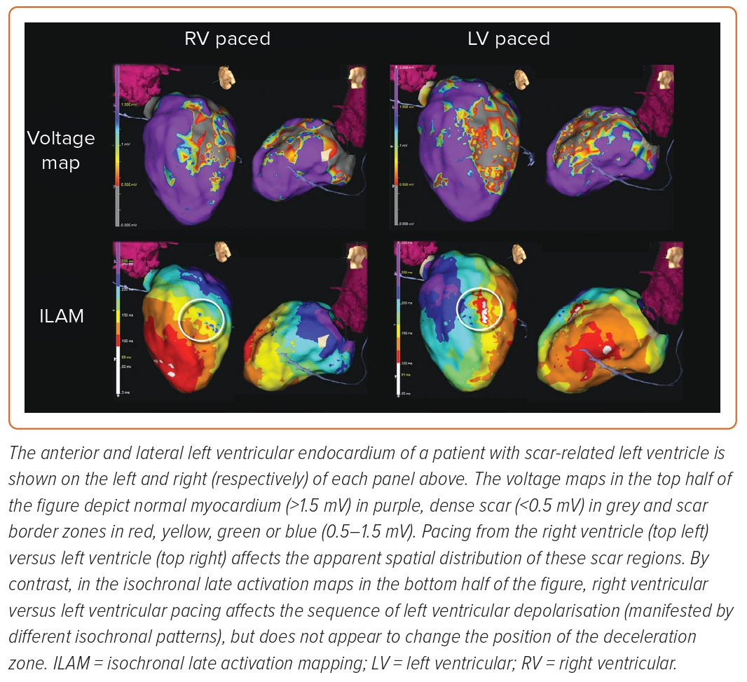
Freedman BL, Maher TR, Tracey M, Santangeli P, d’Avila A
Figure 3 : Activation Wave Front Dependence of Voltage and Isochronal Late Activation Mapping
Citation: Arrhythmia & Electrophysiology Review 2023;12:e20.
https://doi.org/10.15420/aer.2022.24

