Slide 1
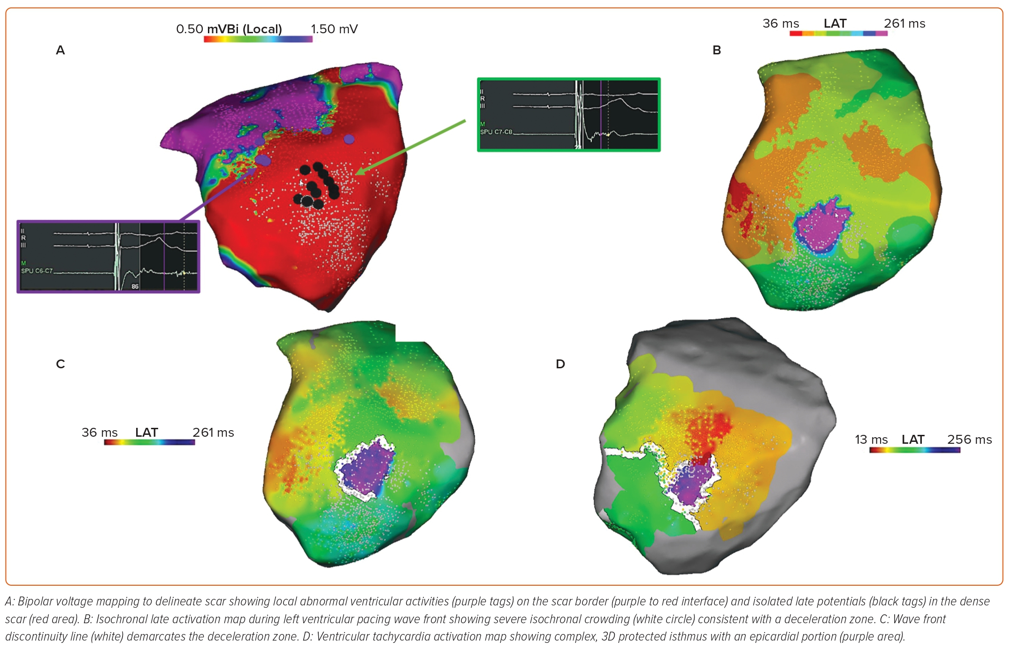
Freedman BL, Maher TR, Tracey M, Santangeli P, d’Avila A
Figure 4: Substrate Ablation and Ventricular Tachycardia Activation Mapping of Left Ventricular Lateral Epicardial Ventricular Tachycardia
Citation: Arrhythmia & Electrophysiology Review 2023;12:e20.
https://doi.org/10.15420/aer.2022.24

