Slide 1
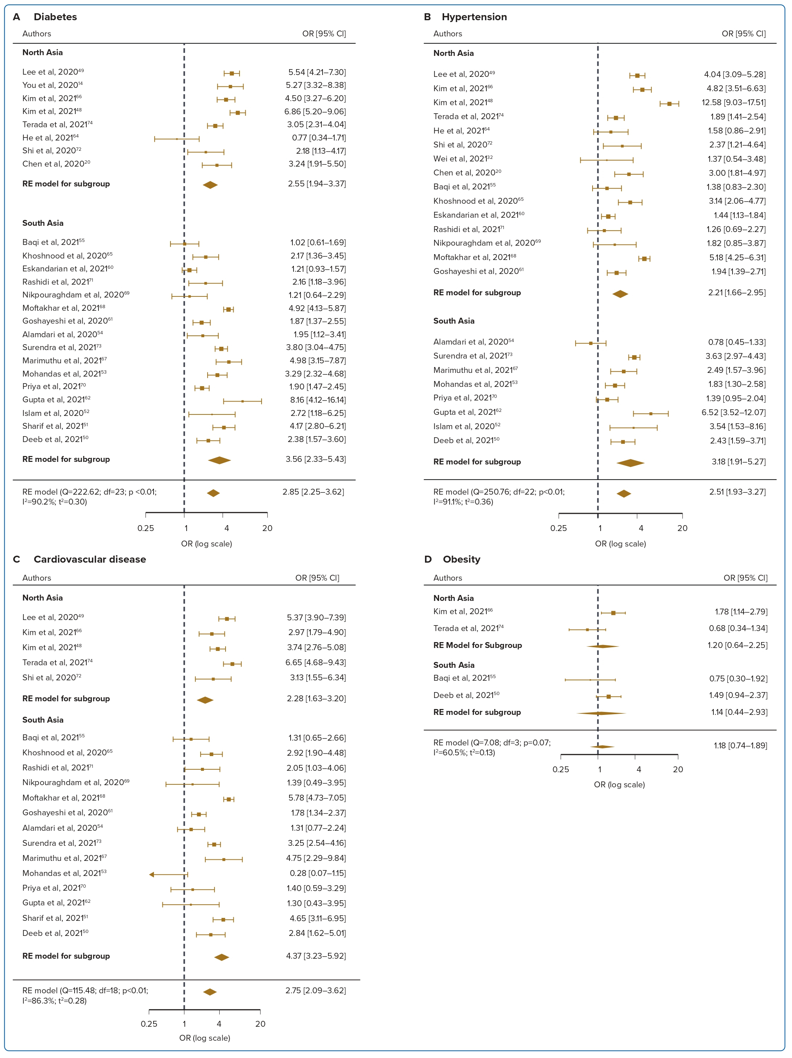
Fong RY, Lee A, Gao F, Yap JJL, Yeo KK
Figure 2: Forest Plots for Mortality Associations in COVID-19 Patients
Citation: Journal of Asian Pacific Society of Cardiology 2023;2:e22.
https://doi.org/10.15420/japsc.2022.27

