Slide 1
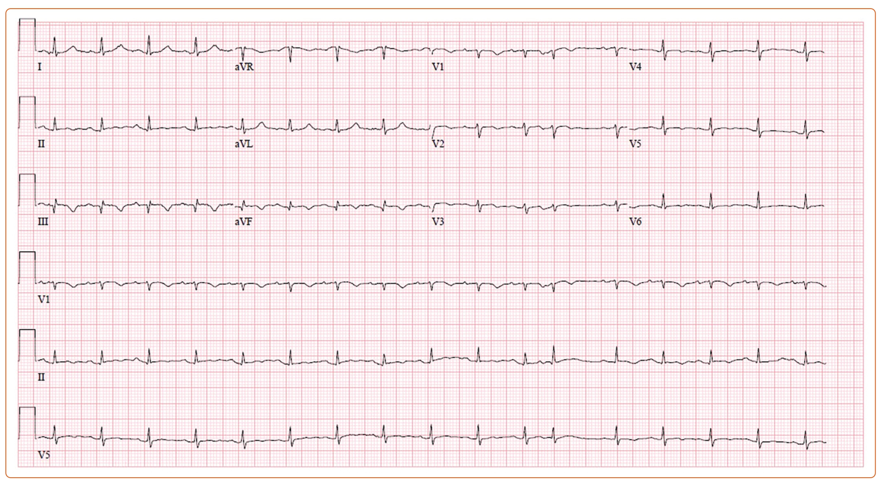
Lee K, Minga I, Cameron E, Pablo Salazar Adum J, Pursnani A
Figure 1: Initial EKG on Presentation
Citation: US Cardiology Review 2023;17:e08.
https://doi.org/10.15420/usc.2022.31

