Slide 1
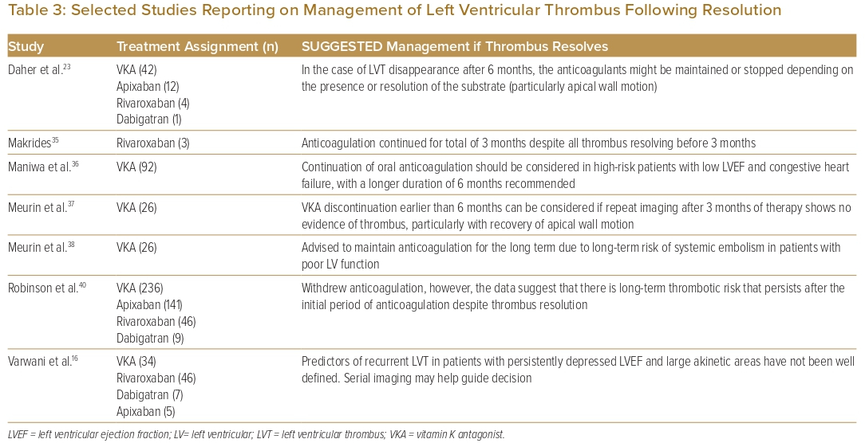
Jiang H, Cader FA, Al-Omary M, Cuenza L, Surunchupakorn P, Hei Ho K, Sung J, Olof SA, Tan JW, Yap JJL
Selected Studies Reporting on Management of Left Ventricular Thrombus Following Resolution
Citation: Journal of Asian Pacific Society of Cardiology 2023;2:e23.
https://doi.org/10.15420/japsc.2022.52

