Slide 1
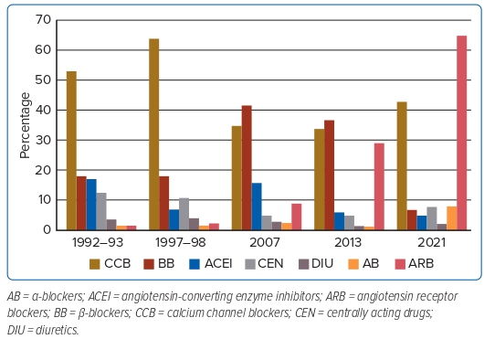
Sison JA
Figure 2: Antihypertensive Drugs Used in the Philippines Over Time
Citation: Journal of Asian Pacific Society of Cardiology 2023;2:e24.
https://doi.org/10.15420/japsc.2022.16

