Slide 1
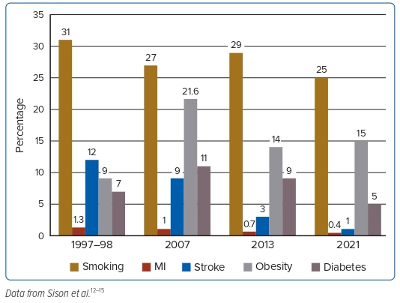
Sison JA
Figure 3: Risk Profile of Filipinos With Hypertension
Citation: Journal of Asian Pacific Society of Cardiology 2023;2:e24.
https://doi.org/10.15420/japsc.2022.16

