Slide 1
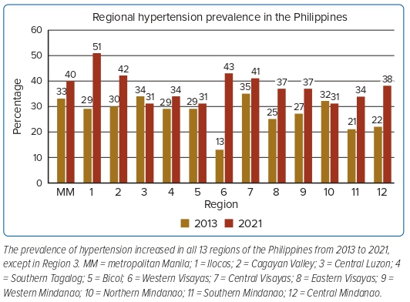
Sison JA
Figure 4: Prevalence of Hypertension in Different Regions of the Philippines
Citation: Journal of Asian Pacific Society of Cardiology 2023;2:e24.
https://doi.org/10.15420/japsc.2022.16

