Slide 1
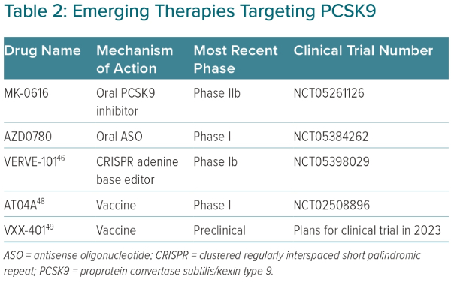
Rikhi R, Shapiro MD
Emerging Therapies Targeting PCSK9
Citation: European Cardiology Review 2023;18:e45.
https://doi.org/10.15420/ecr.2023.14

