Slide 1
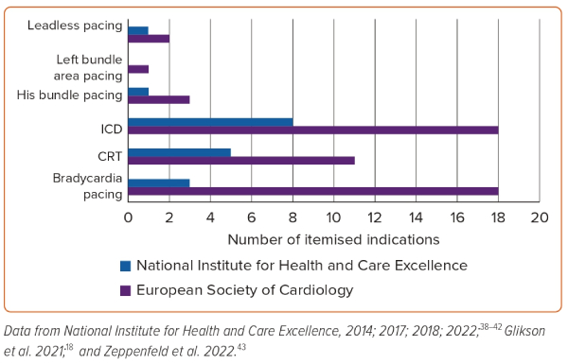
Naraen A, Duvva D, Rao A
Figure 1: Number of Indications Reported for Device Therapy: European Society of Cardiology versus National Institute for Health and Care Excellence
Citation: Arrhythmia & Electrophysiology Review 2023;12:e21.
https://doi.org/10.15420/aer.2022.35

