Slide 1
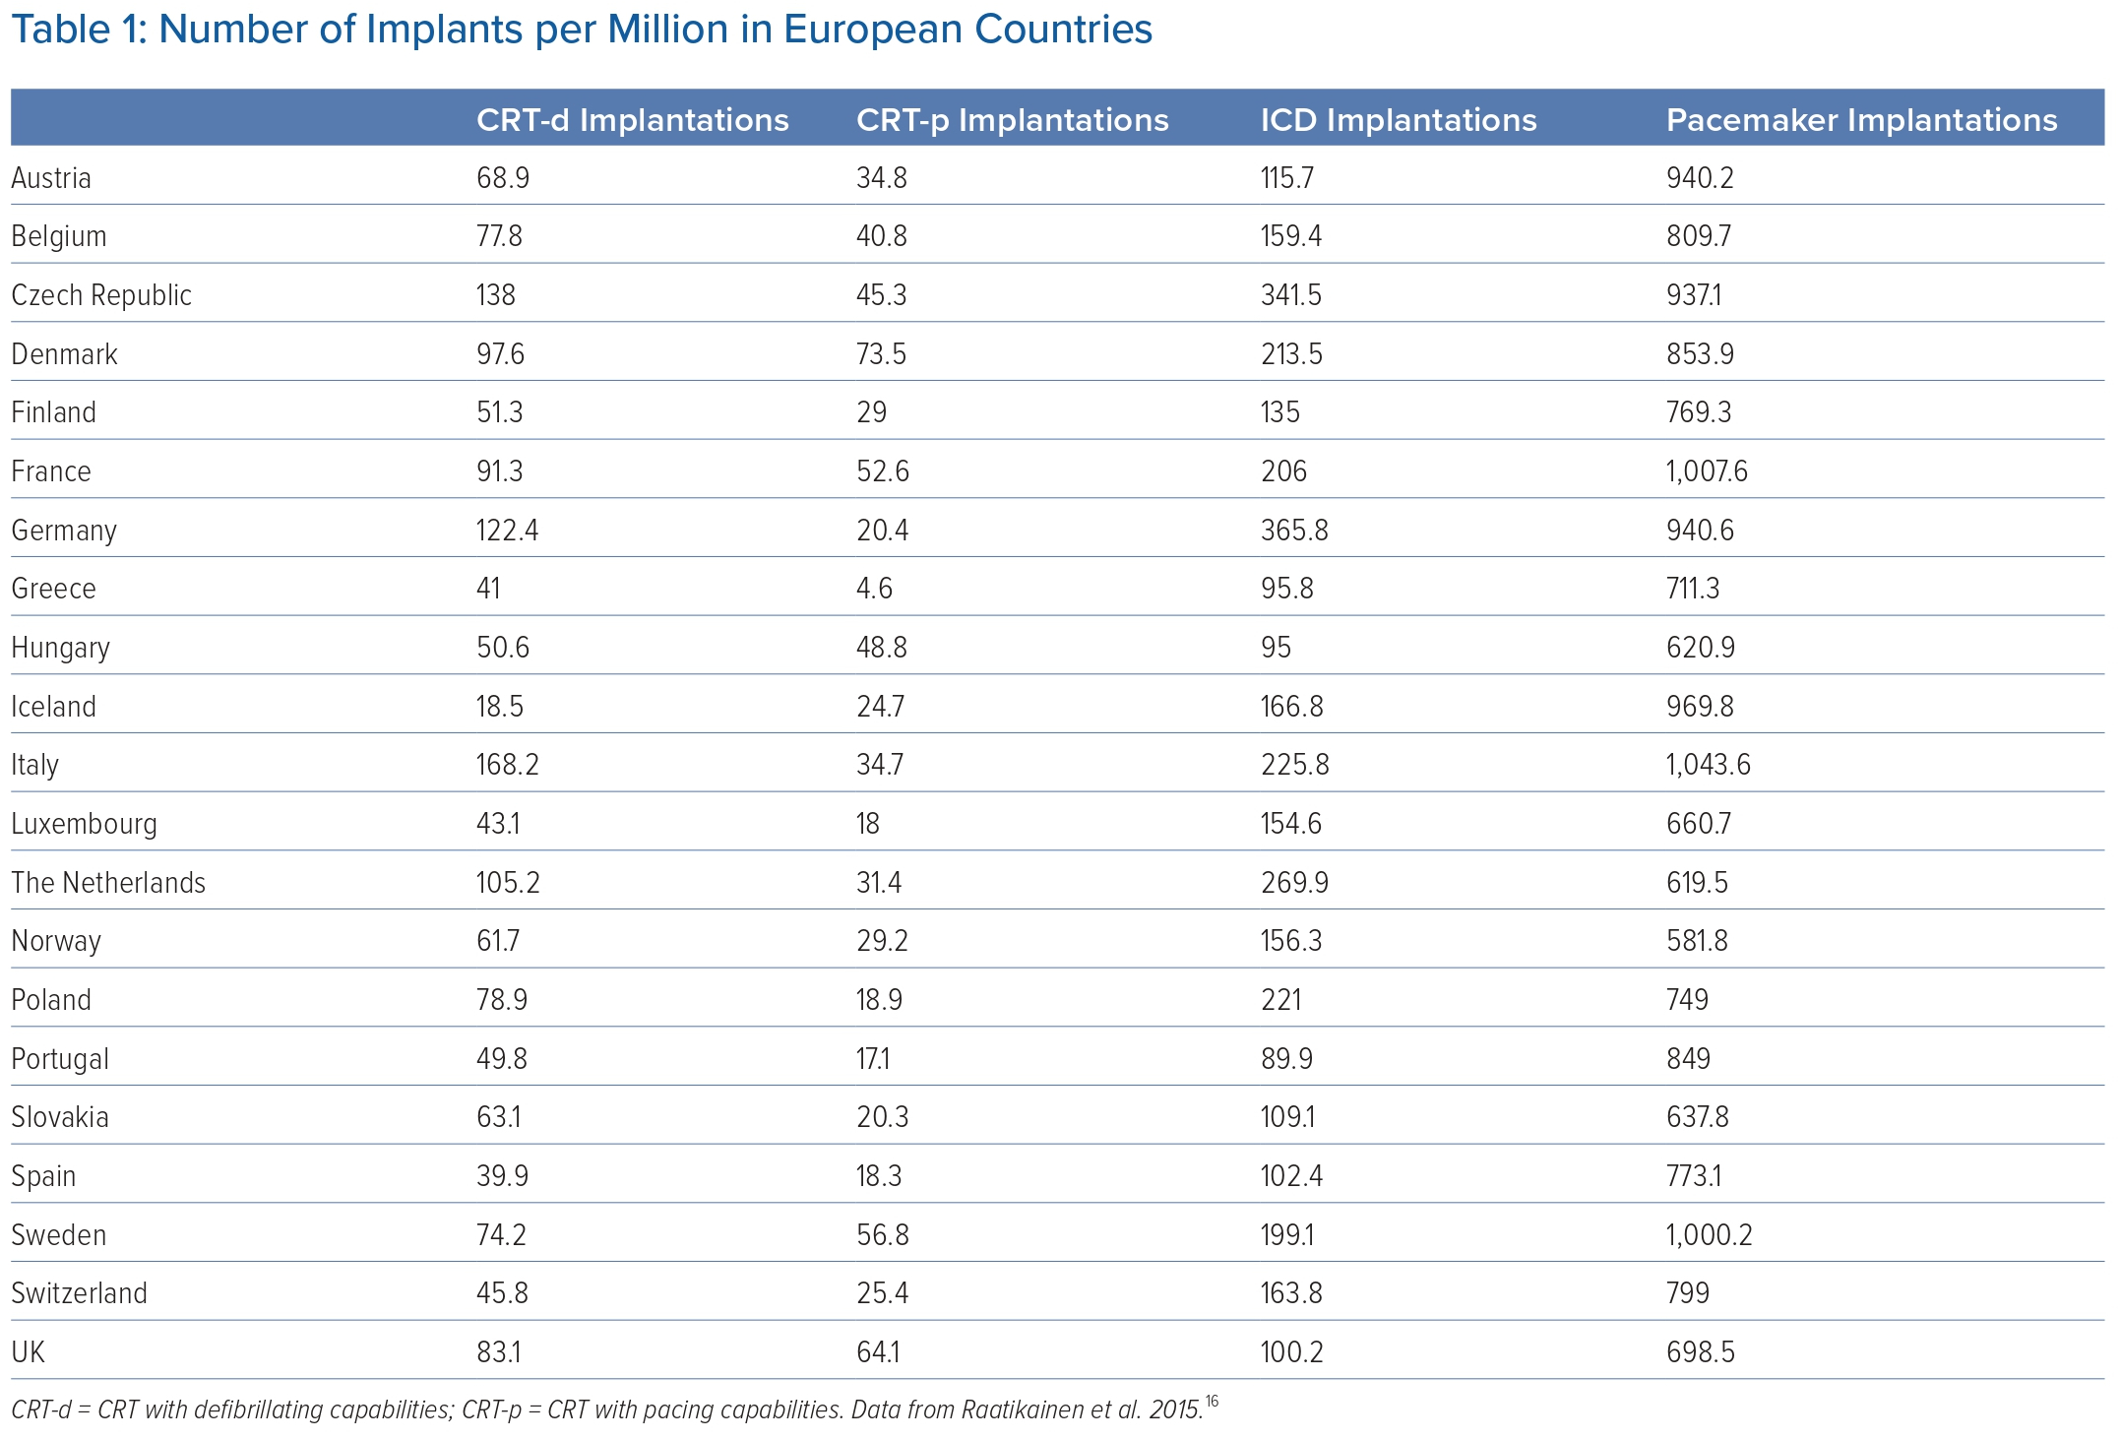
Naraen A, Duvva D, Rao A
Number of Implants per Million in European Countries
Citation: Arrhythmia & Electrophysiology Review 2023;12:e21.
https://doi.org/10.15420/aer.2022.35

