Slide 1
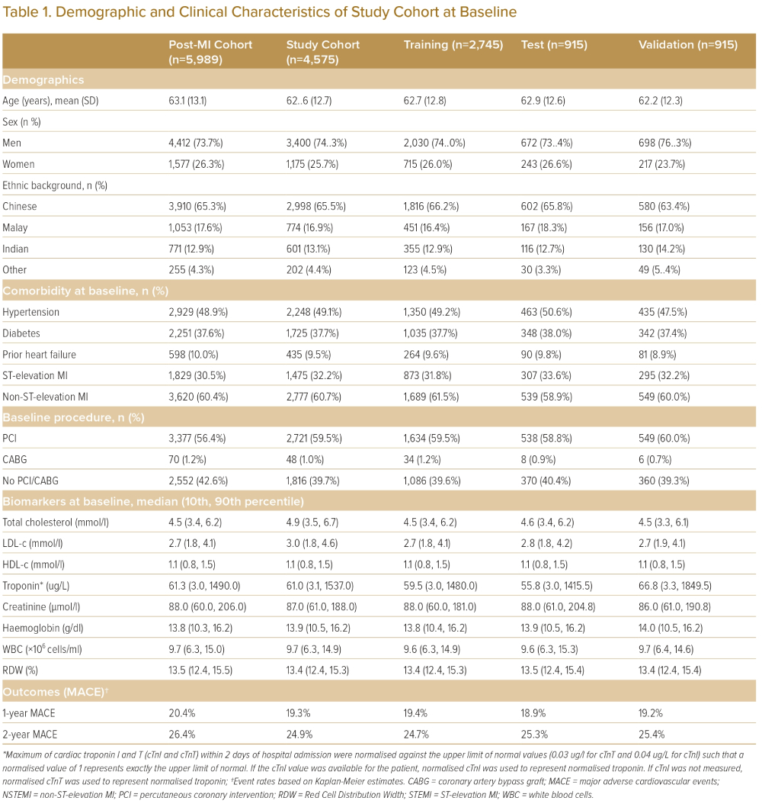
He F, Page JH, Tandi J, Ghosh A, Liman C, Sarkar J, Yeo KK
Demographic and Clinical Characteristics of Study Cohort at Baseline
Citation: Journal of Asian Pacific Society of Cardiology 2023;2:e25.
https://doi.org/10.15420/japsc.2022.26

