Slide 1
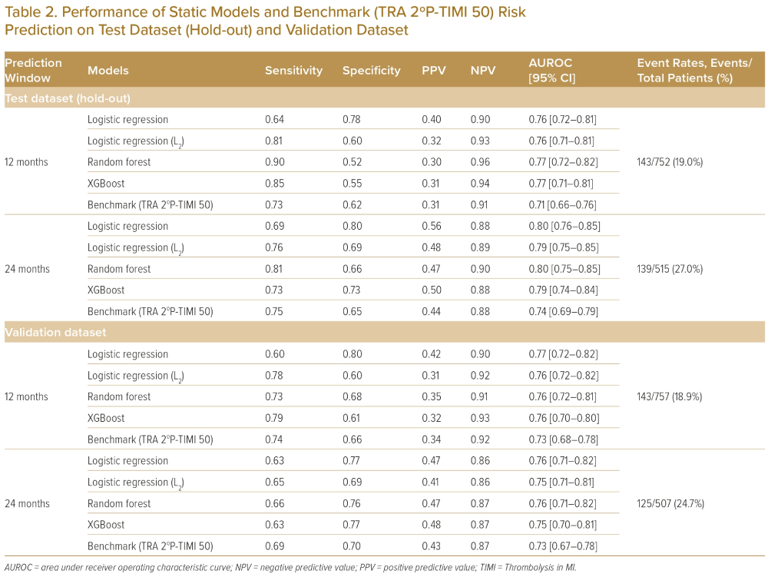
He F, Page JH, Tandi J, Ghosh A, Liman C, Sarkar J, Yeo KK
Performance of Static Models and Benchmark (TRA 2ºP-TIMI 50) Risk Prediction on Test Dataset (Hold-out) and Validation Dataset
Citation: Journal of Asian Pacific Society of Cardiology 2023;2:e25.
https://doi.org/10.15420/japsc.2022.26

