Slide 1
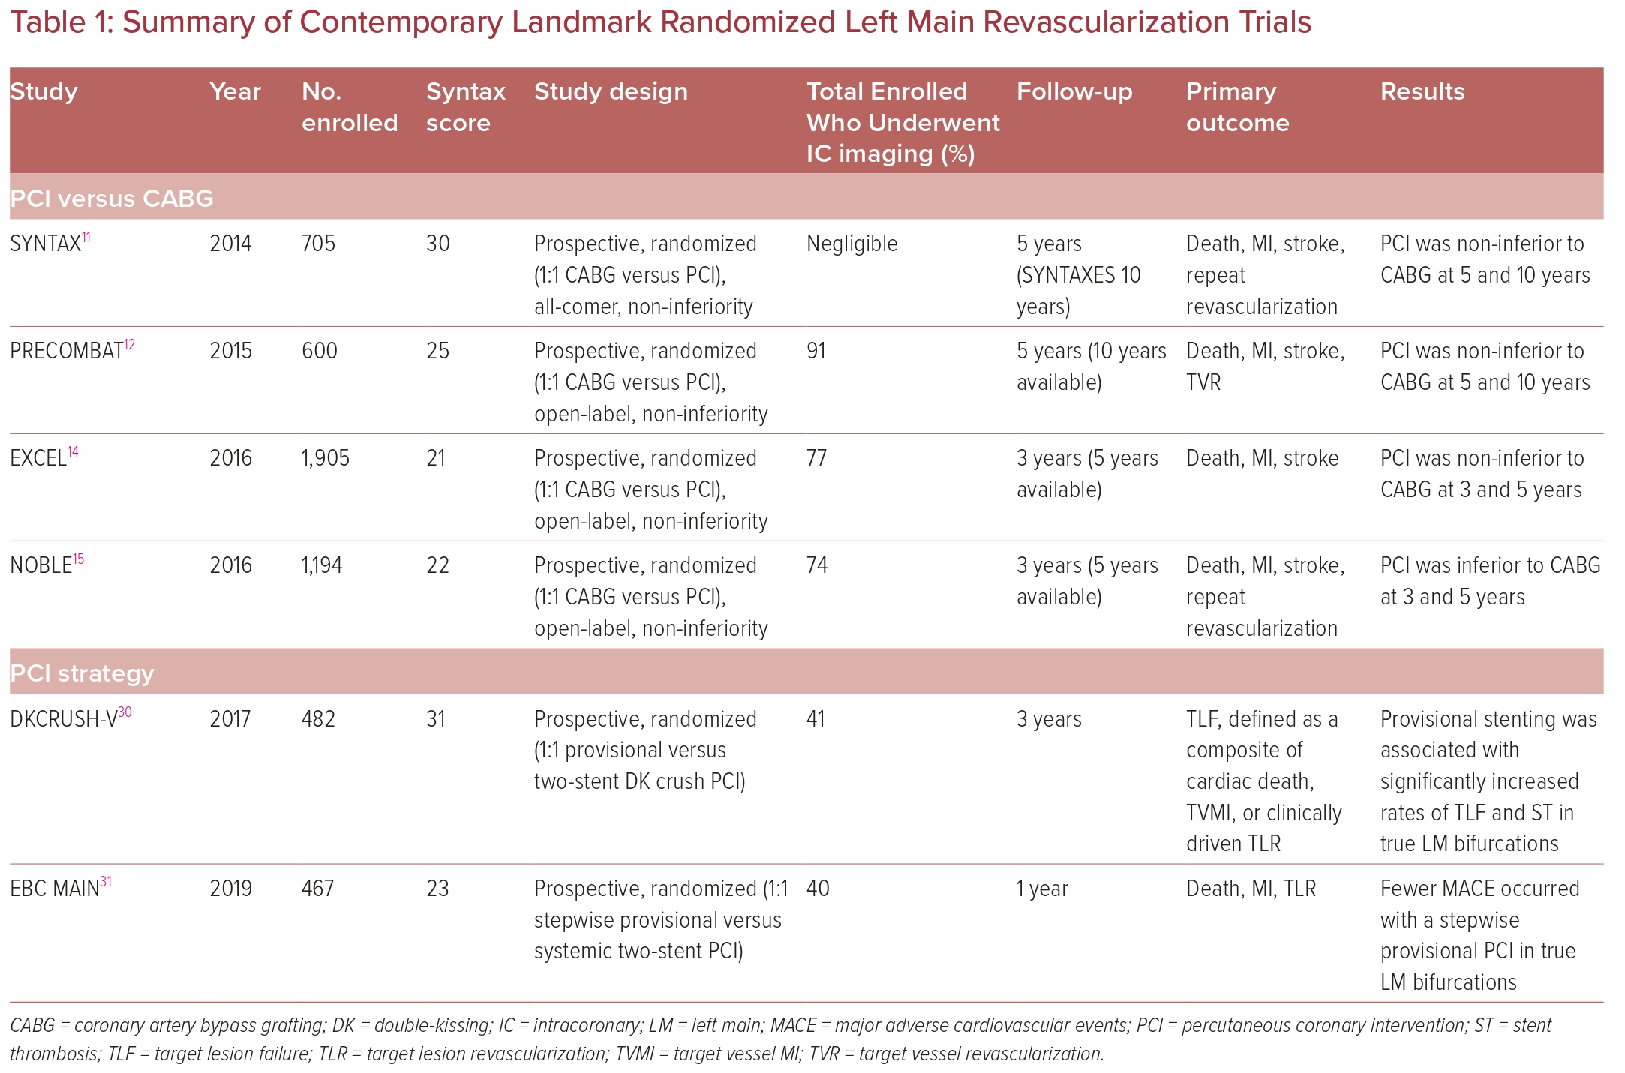
Almoghairi A, Al-Asiri N, Al Johani K, AlSaleh A, Alqahtani NG, Alasmary M, Alali R, Tamam K, Alasnag M
Summary of Contemporary Landmark Randomized Left Main Revascularization Trials
Citation: US Cardiology Review 2023;17:e09.
https://doi.org/10.15420/usc.2022.24

