Slide 1
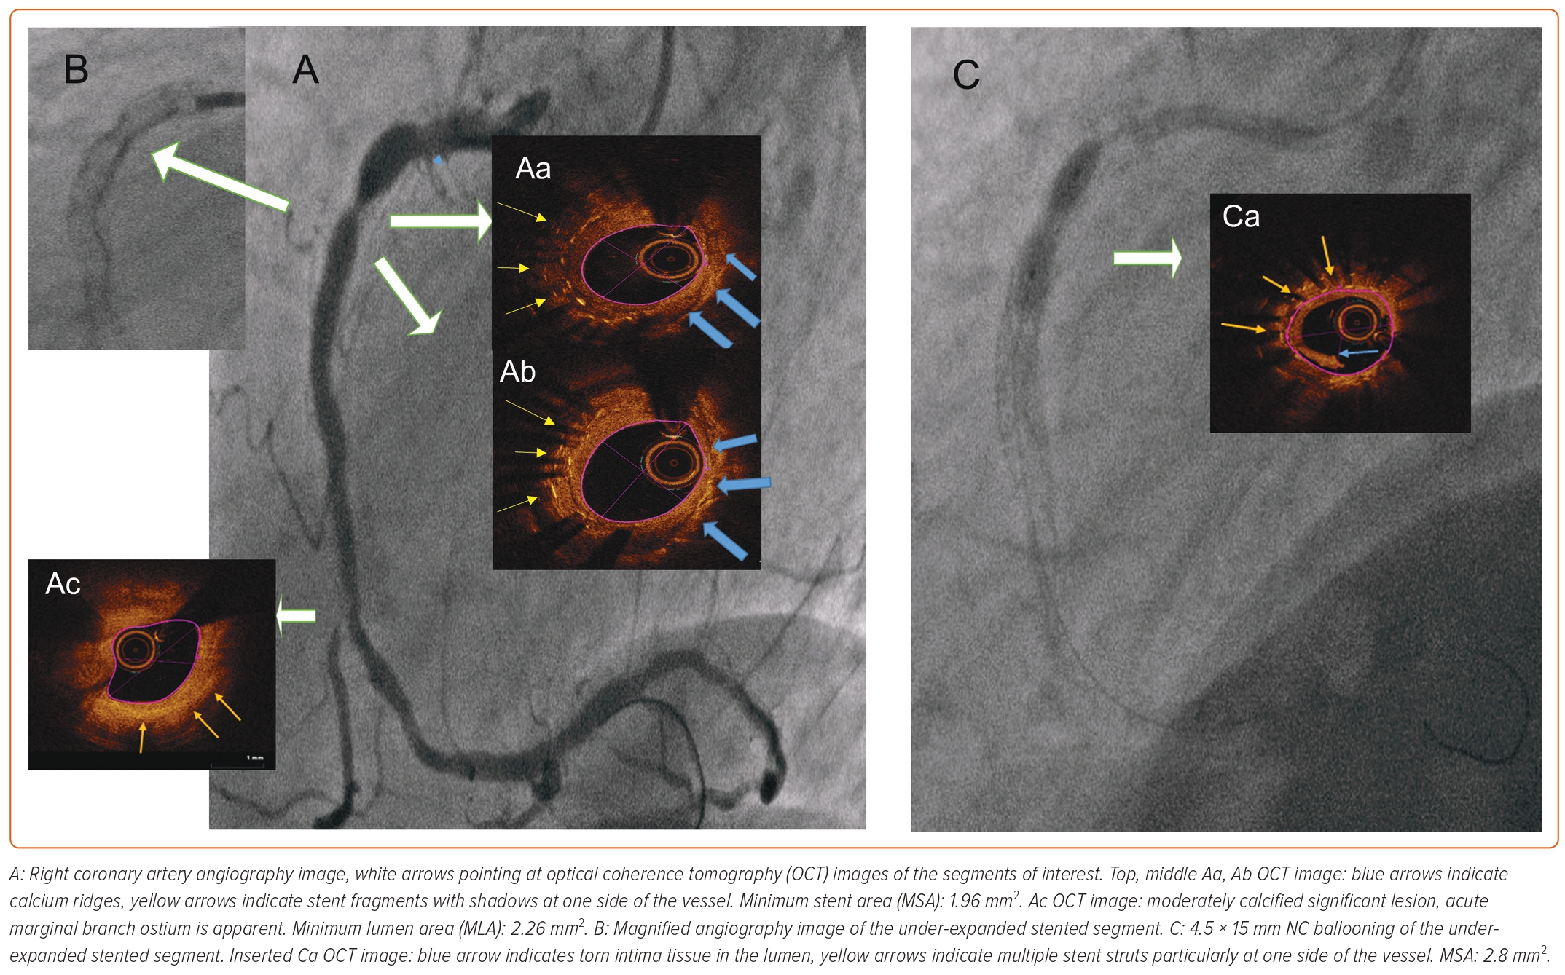
Sasi V, Szántó G, Achim A, Ungi I, Varga A, Ruzsa Z
Figure 1: Diagnostic Angiographic and Optical Coherence Tomography Images of Under-expanded Stented Right Coronary Artery Segment and Failure of Conventional Balloon Angioplasty
Citation: Interventional Cardiology 2023;18:e23.
https://doi.org/10.15420/icr.2022.36

