Slide 1
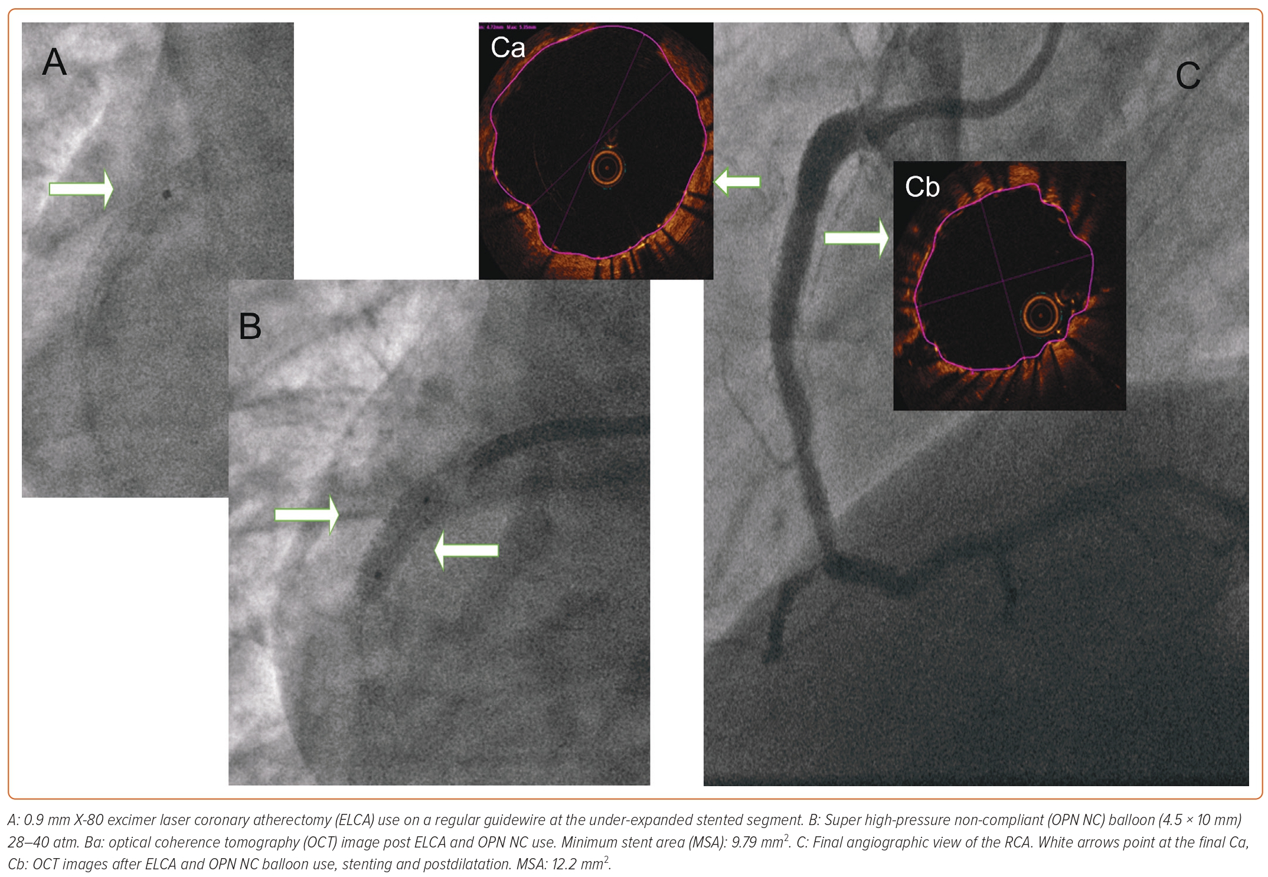
Sasi V, Szántó G, Achim A, Ungi I, Varga A, Ruzsa Z
Figure 2: Angiographic and Optical Coherence Tomography Images of Laser, Super High-pressure Non-compliant Balloon Successful Treatment
Citation: Interventional Cardiology 2023;18:e23.
https://doi.org/10.15420/icr.2022.36

