Slide 1
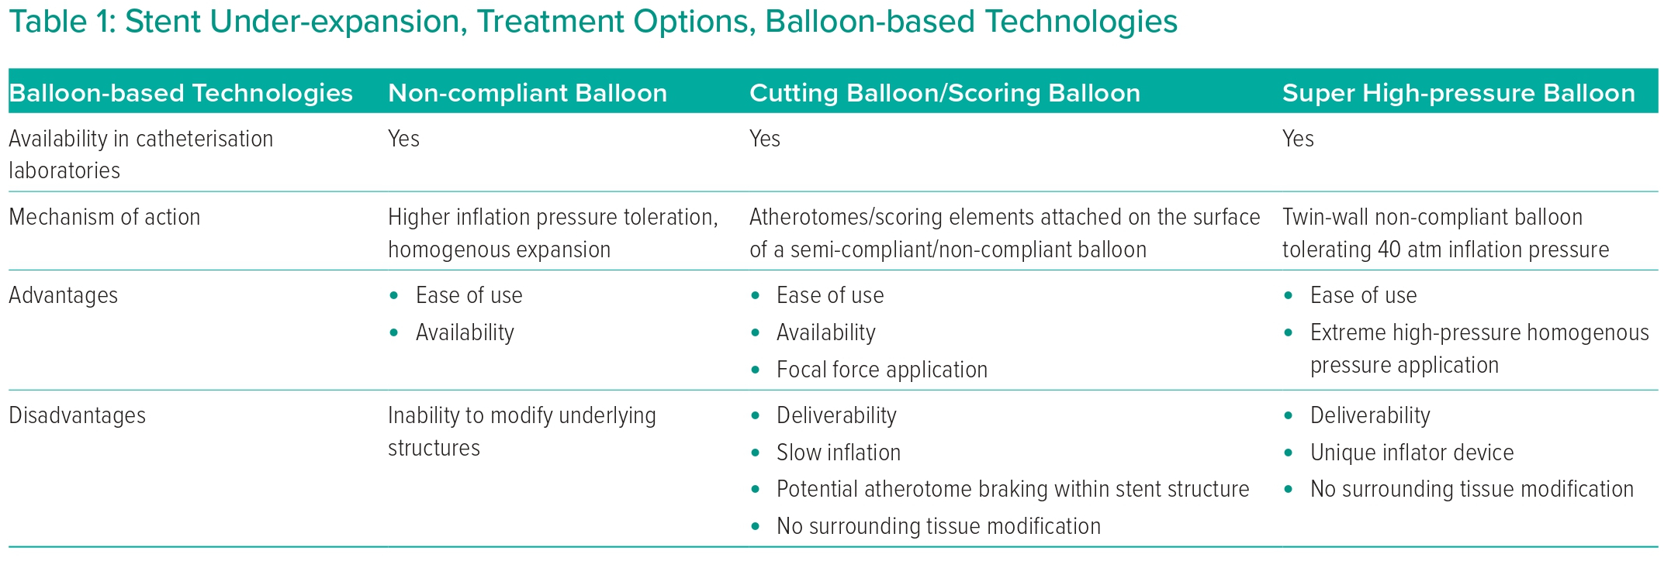
Sasi V, Szántó G, Achim A, Ungi I, Varga A, Ruzsa Z
Stent Under-expansion, Treatment Options, Balloon-based Technologies
Citation: Interventional Cardiology 2023;18:e23.
https://doi.org/10.15420/icr.2022.36

