Slide 1
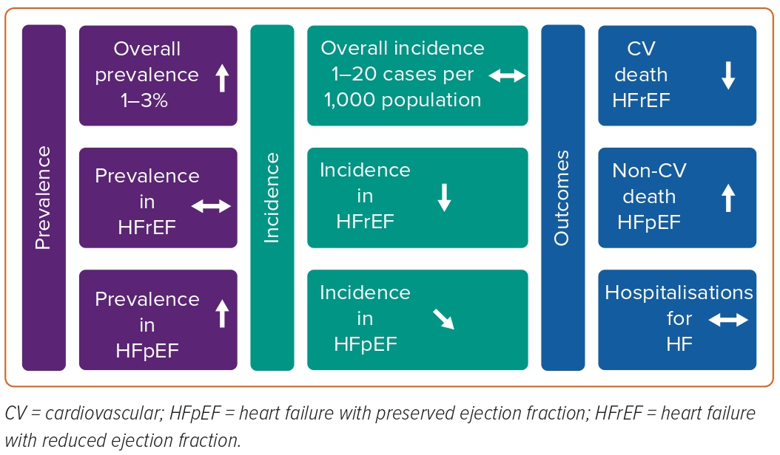
Shahim B, Kapelios CJ, Savarese G, Lund LH
Figure 3: Summary of Trends in Global Burden of Heart Failure
Citation: Cardiac Failure Review 2023;9:e11.
https://doi.org/10.15420/cfr.2023.05

