Slide 1
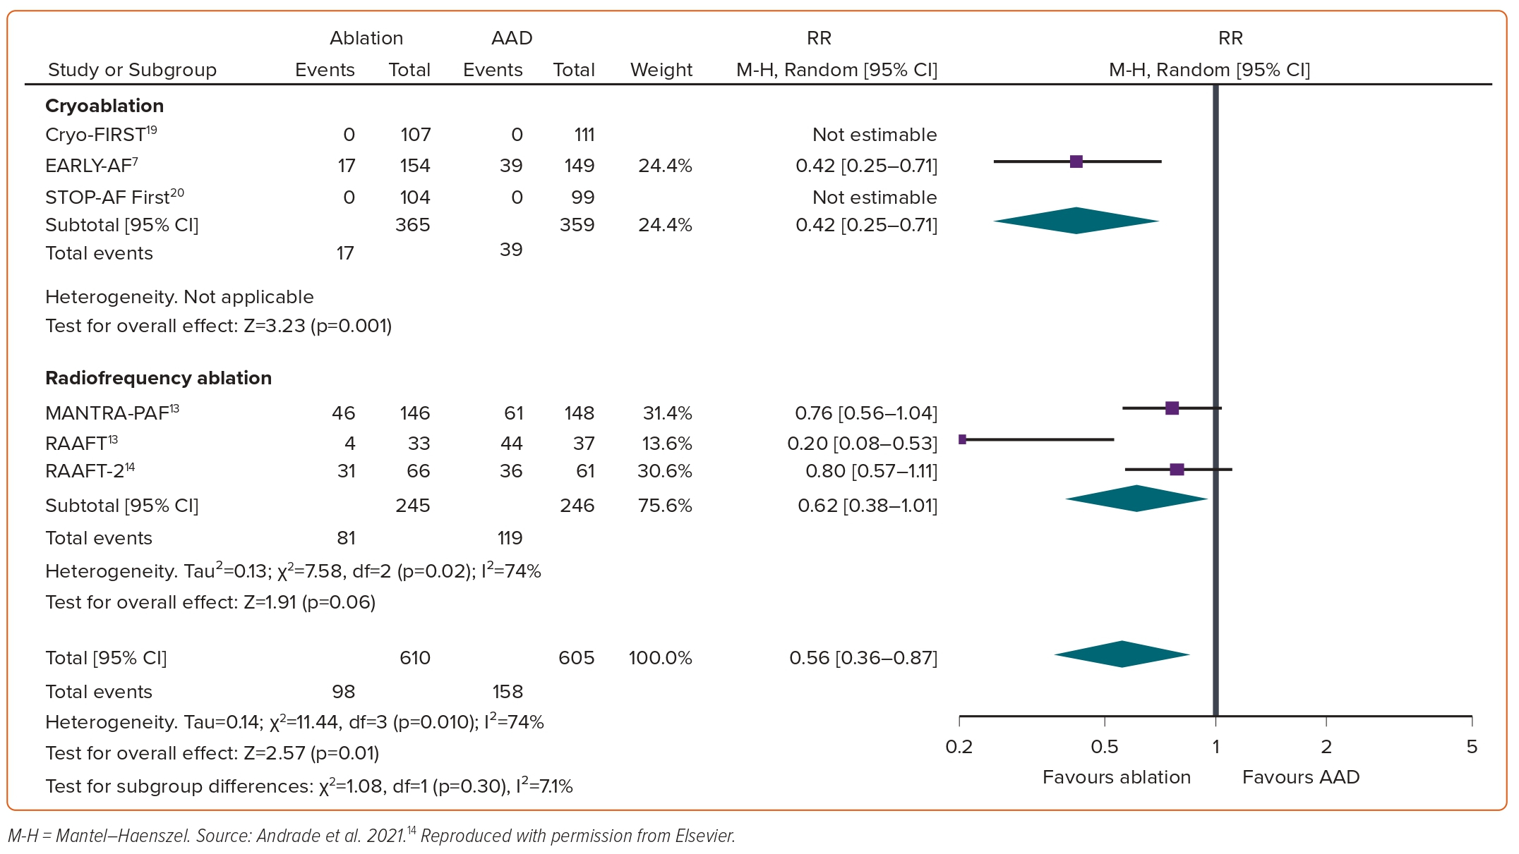
Andrade JG
Figure 2: Recurrence of Symptomatic Atrial Tachyarrhythmia, Stratified by Ablation Energy
Citation: European Cardiology Review 2023;18:e46.
https://doi.org/10.15420/ecr.2023.04

