Slide 1
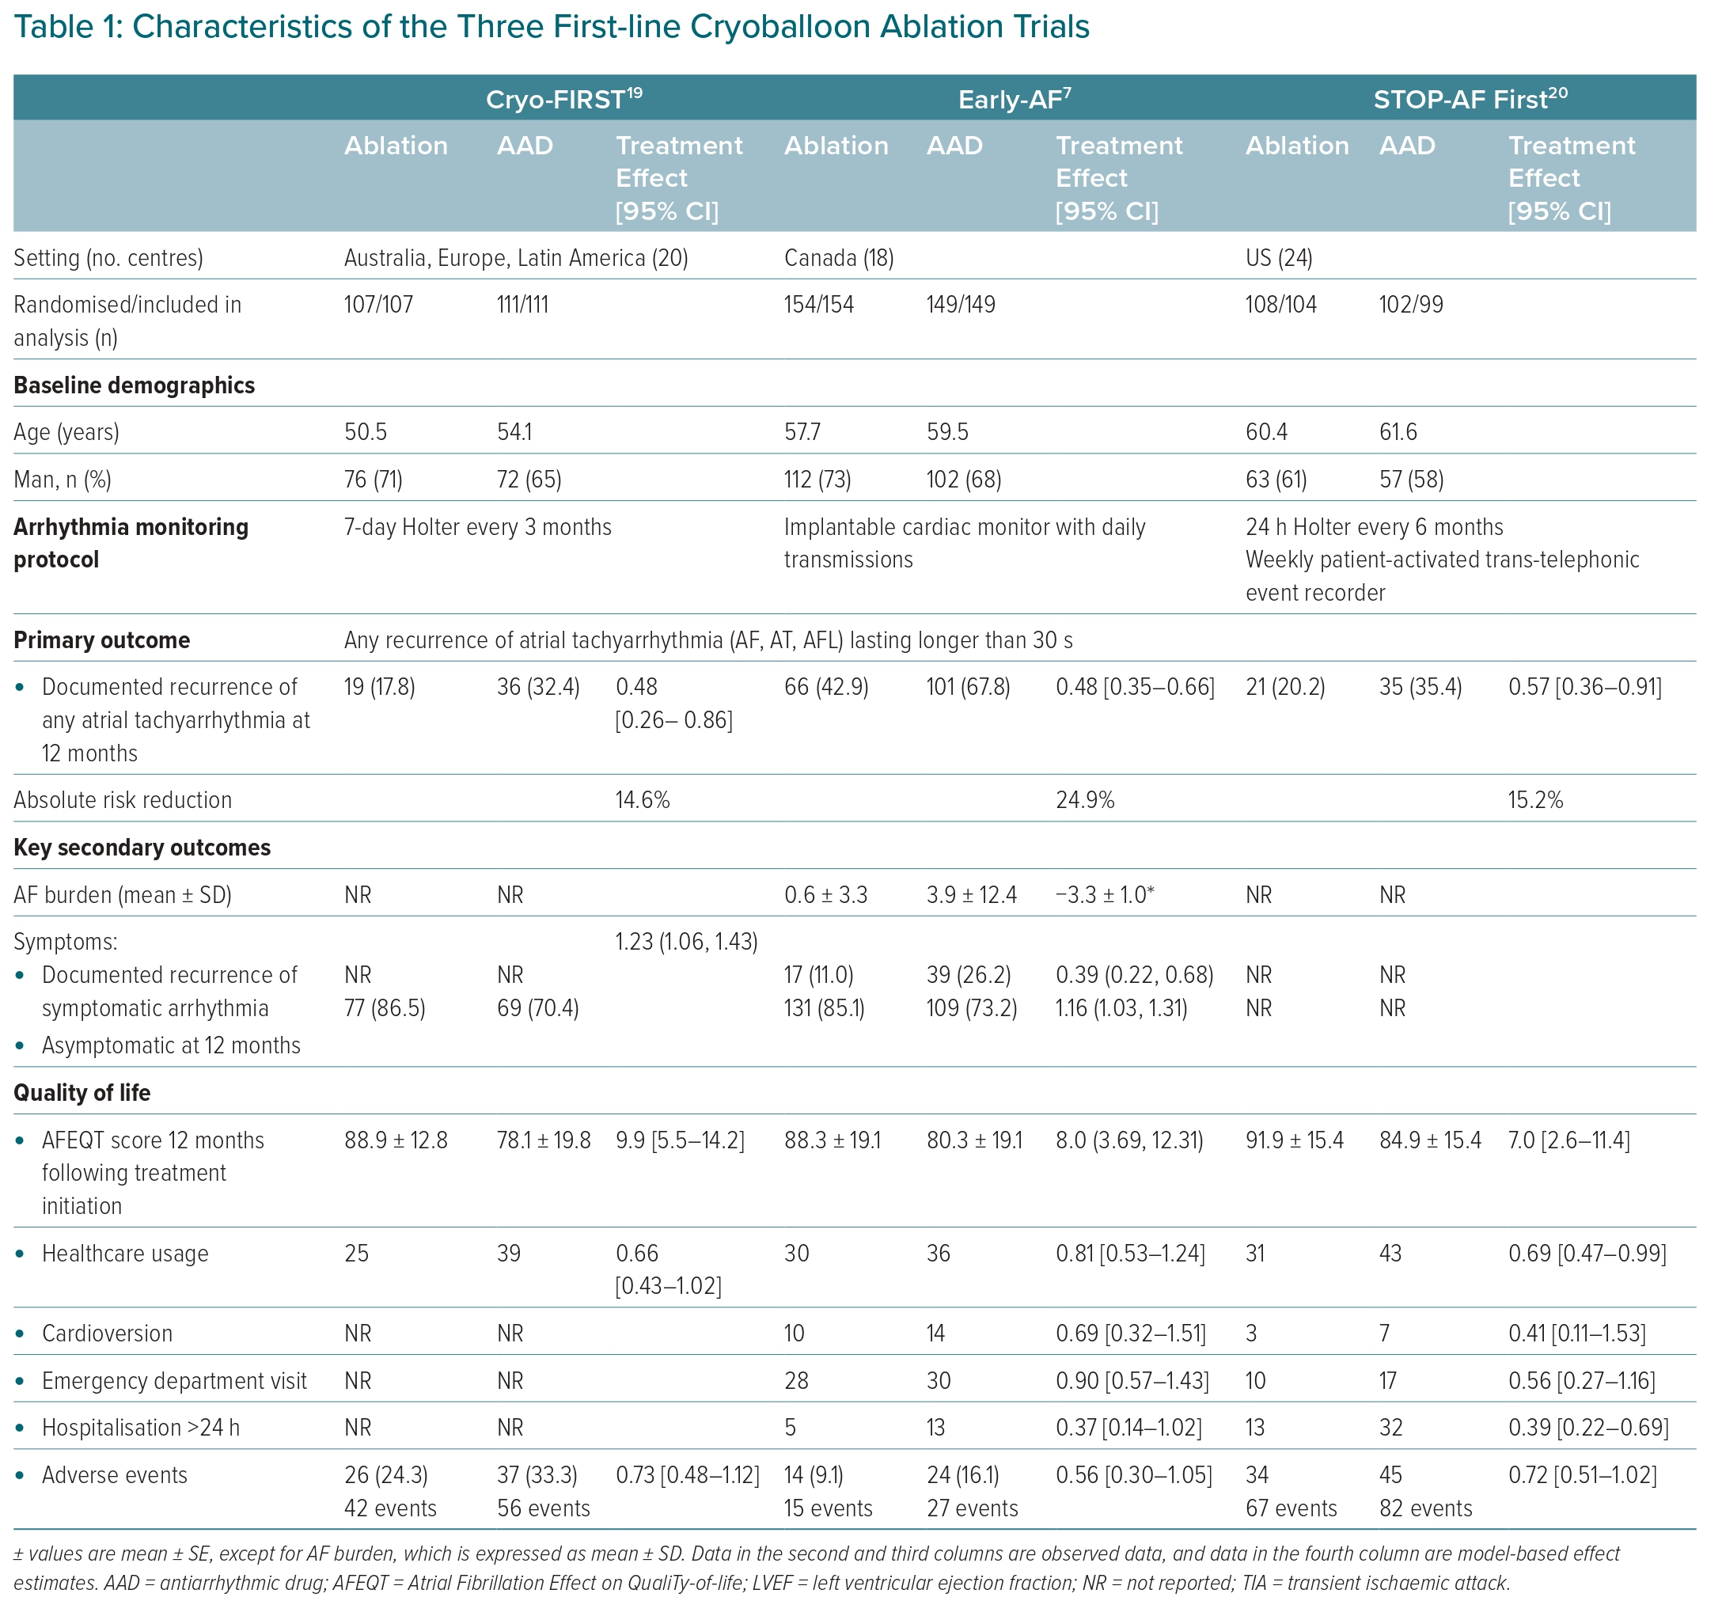
Andrade JG
Characteristics of the Three First-line Cryoballoon Ablation Trials
Citation: European Cardiology Review 2023;18:e46.
https://doi.org/10.15420/ecr.2023.04

