Slide 1
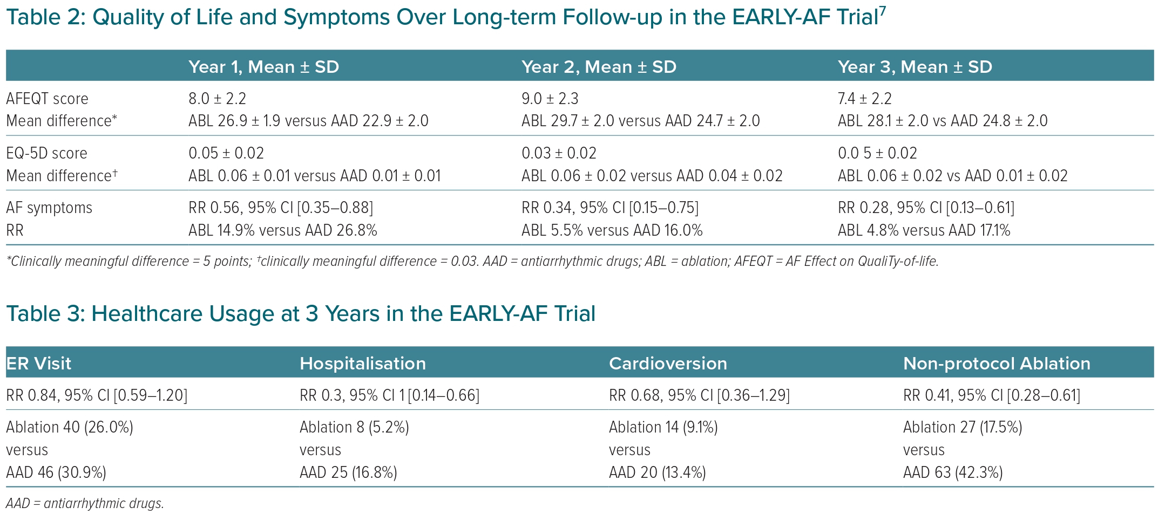
Andrade JG
Quality of Life and Symptoms Over Long-term Follow-up in the EARLY-AF Trial
Citation: European Cardiology Review 2023;18:e46.
https://doi.org/10.15420/ecr.2023.04

