Slide 1
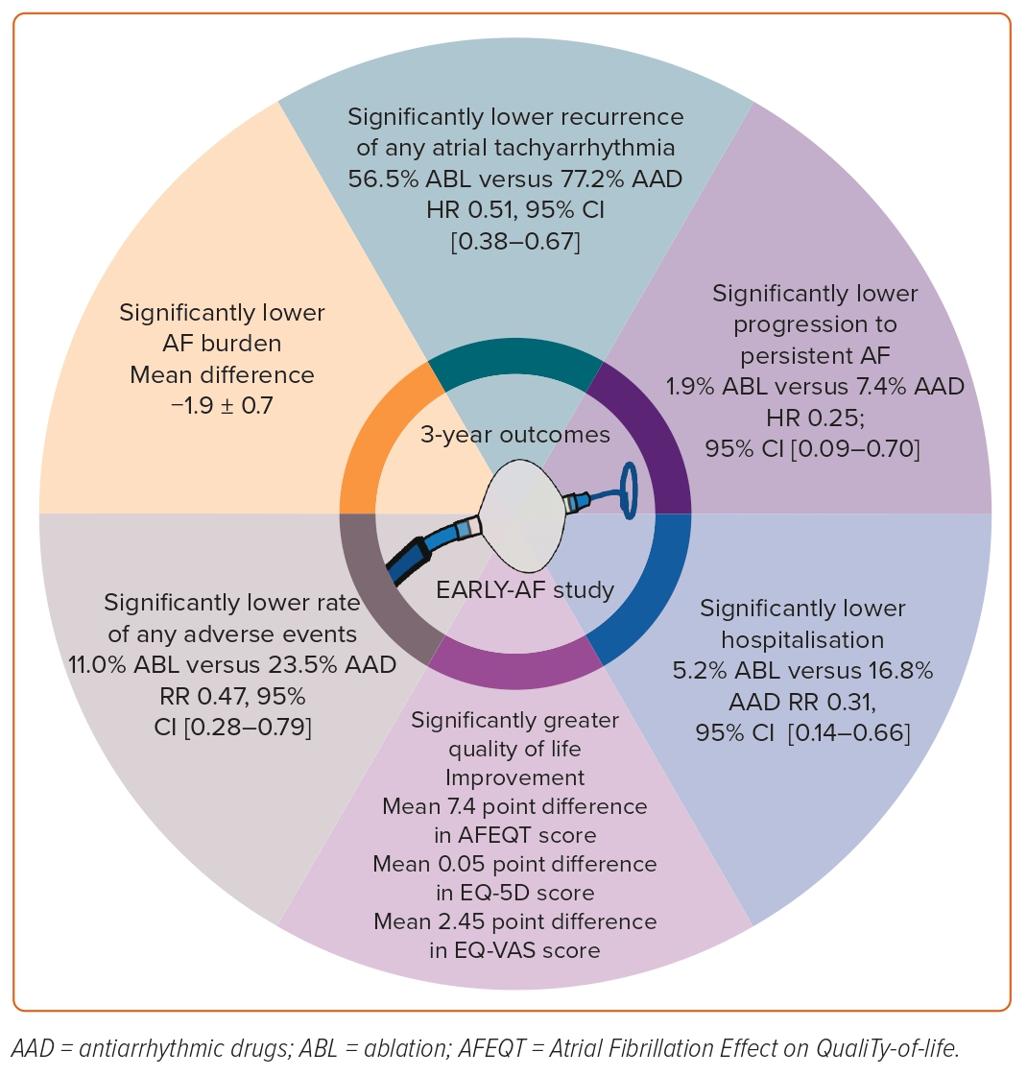
Andrade JG
Figure 3: Long-term Benefits of First-line Catheter Ablation for Paroxysmal AF, as Observed at 3-year Follow-up in the EARLY-AF Trial7
Citation: European Cardiology Review 2023;18:e46.
https://doi.org/10.15420/ecr.2023.04

