Slide 1
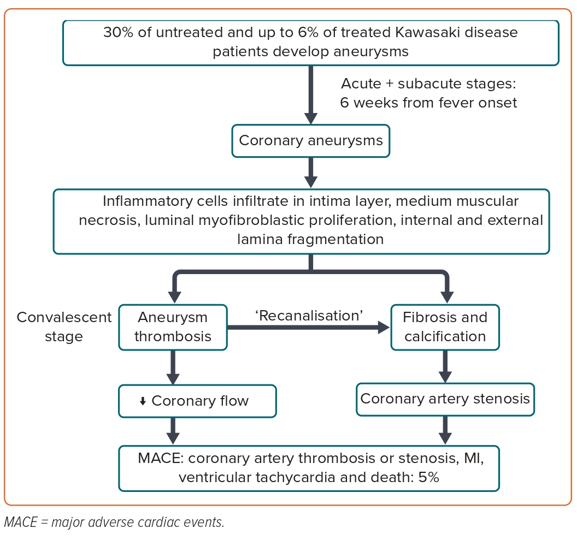
Cavalcanti Lianza A, de Fátima Rodrigues Diniz M, Saori Shiraishi Sawamura K, da Rocha Brito Menezes C, de Sousa Lobo Silva I, Nunes Leal G
Figure 2: Pathophysiology of Coronary Artery Lesions in Kawasaki Disease
Citation: European Cardiology Review 2023;18:e47.
https://doi.org/10.15420/ecr.2023.15

