Slide 1
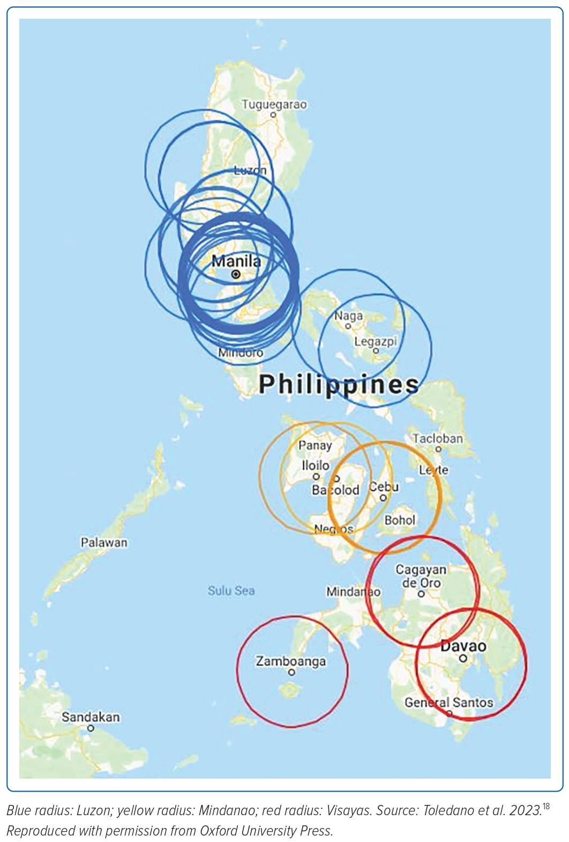
Toledano BRF, Garganera KB, Paolo A Prado J, Sabas ML, Martinez Jr G
Figure 1: Map of Percutaneous Coronar Intervention-capable Hospitals and Their Geographic Areas of Responsibility in the Philippines
Citation: Journal of Asian Pacific Society of Cardiology 2023;2:e26.
https://doi.org/10.15420/japsc.2022.49

