Slide 1
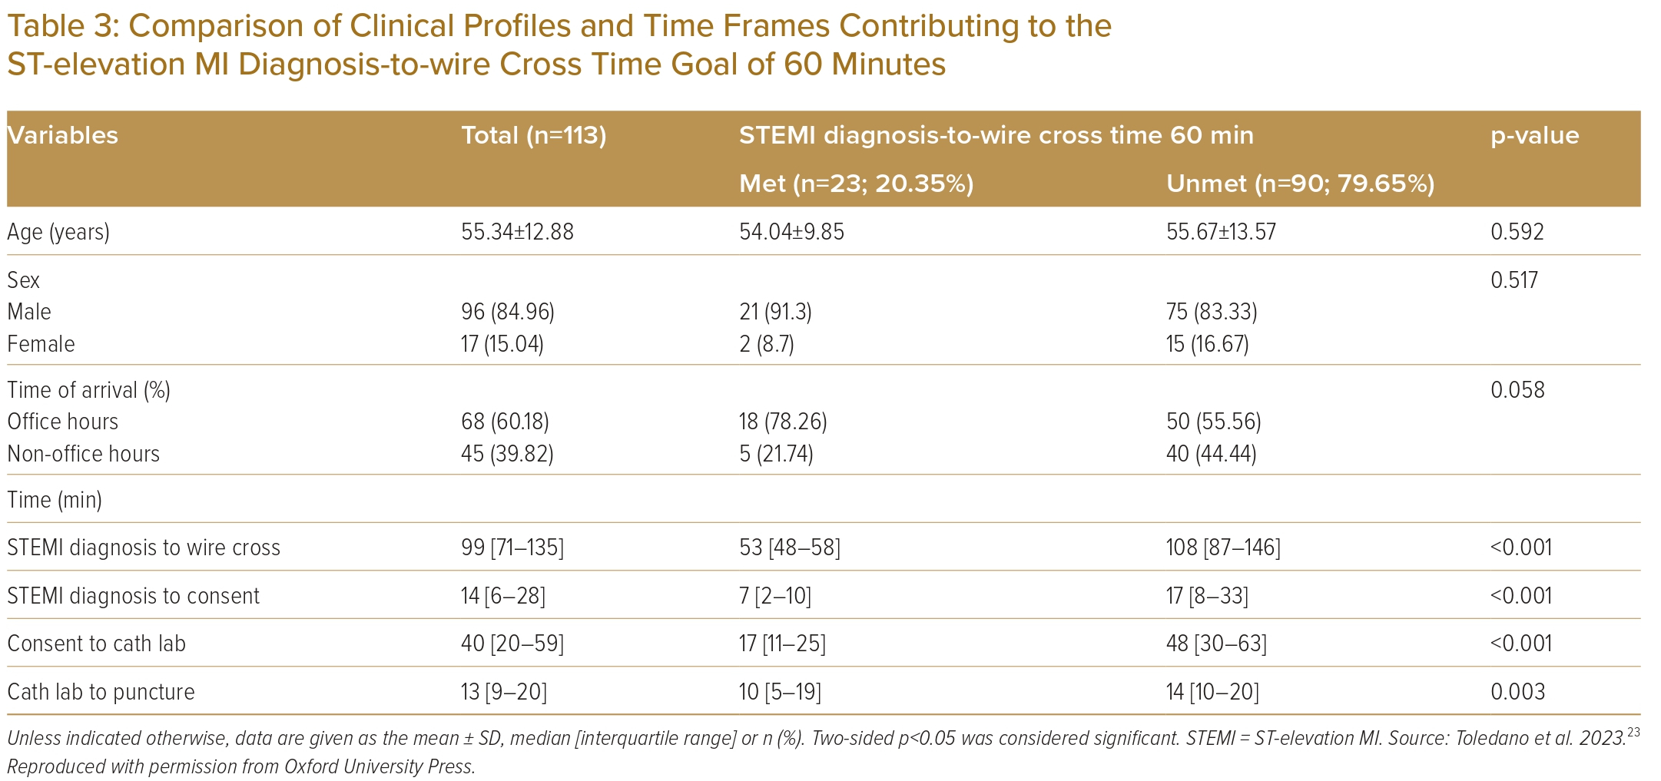
Toledano BRF, Garganera KB, Paolo A Prado J, Sabas ML, Martinez Jr G
Comparison of Clinical Profiles and Time Frames Contributing to the ST-elevation MI Diagnosis-to-wire Cross Time Goal of 60 Minutes
Citation: Journal of Asian Pacific Society of Cardiology 2023;2:e27
https://doi.org/10.15420/japsc.2022.51

