Slide 1
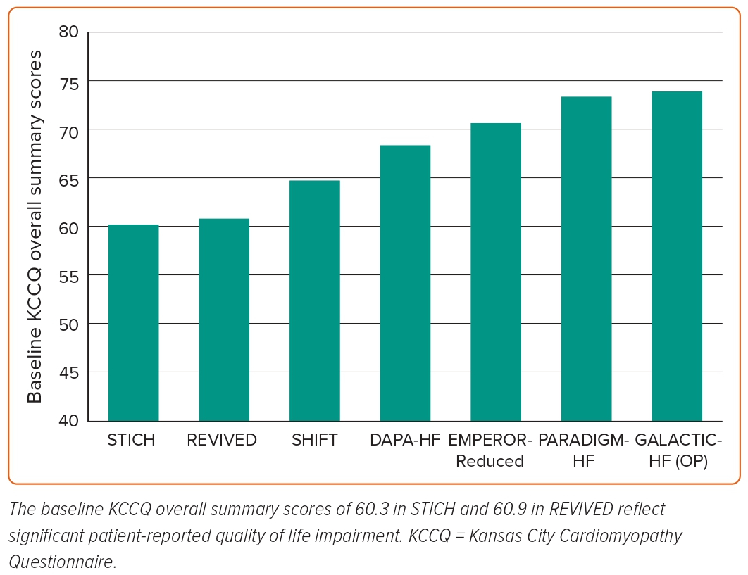
Wa MELK, Assar SZ, Kirtane AJ, Perera D
Figure 2: STICH and REVIVED Quality of Life at Baseline in the Context of Major Heart Failure Trials
Citation: Interventional Cardiology 2023;18:e24.
https://doi.org/10.15420/icr.2023.06

