Slide 1
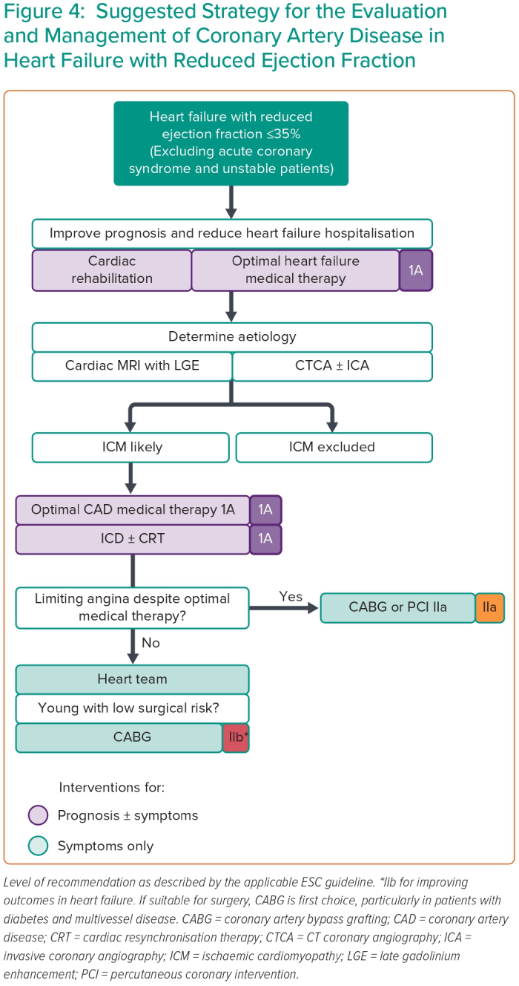
Wa MELK, Assar SZ, Kirtane AJ, Perera D
Figure 4: Suggested Strategy for the Evaluation and Management of Coronary Artery Disease in Heart Failure with Reduced Ejection Fraction
Citation: Interventional Cardiology 2023;18:e24.
https://doi.org/10.15420/icr.2023.06

