Slide 1
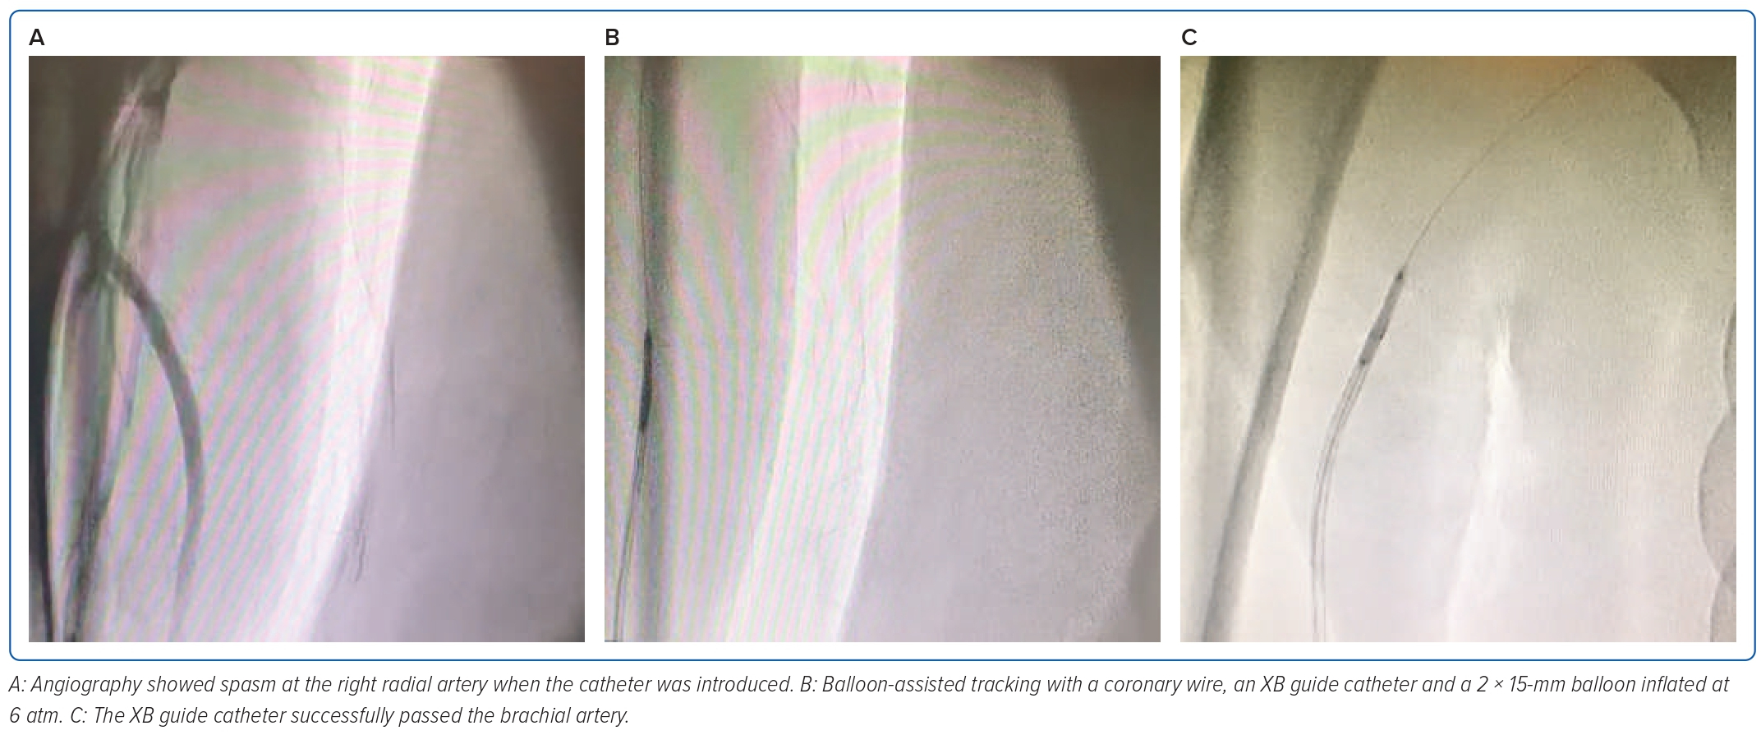
Safitri H, Aziz Alkatiri A, Firman D, Saleh Mangkuanom A, Iryuza N
Figure 2: Balloon-assisted Tracking to Overcome Spasm at the Right Radial Artery in Case 1
Citation: Journal of Asian Pacific Society of Cardiology 2023;2:e28.
https://doi.org/10.15420/japsc.2022.29

