Slide 1
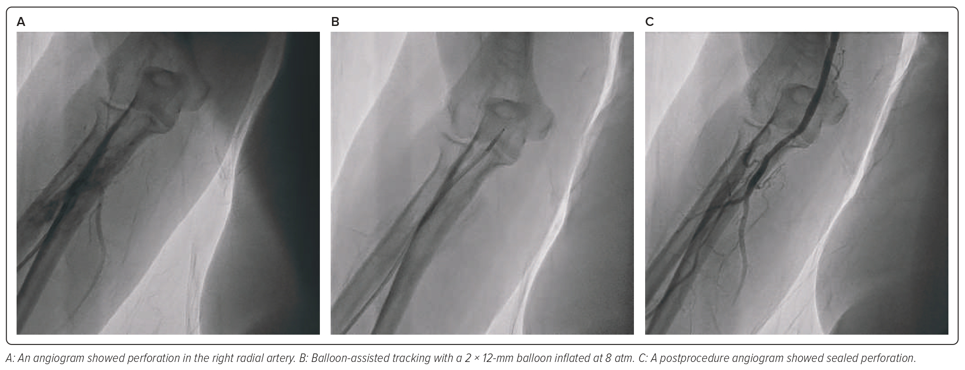
Safitri H, Aziz Alkatiri A, Firman D, Saleh Mangkuanom A, Iryuza N
Figure 4: Balloon-assisted Tracking to Overcome Perforation in the Right Radial Artery in Case 2
Citation: Journal of Asian Pacific Society of Cardiology 2023;2:e28.
https://doi.org/10.15420/japsc.2022.29

