Slide 1
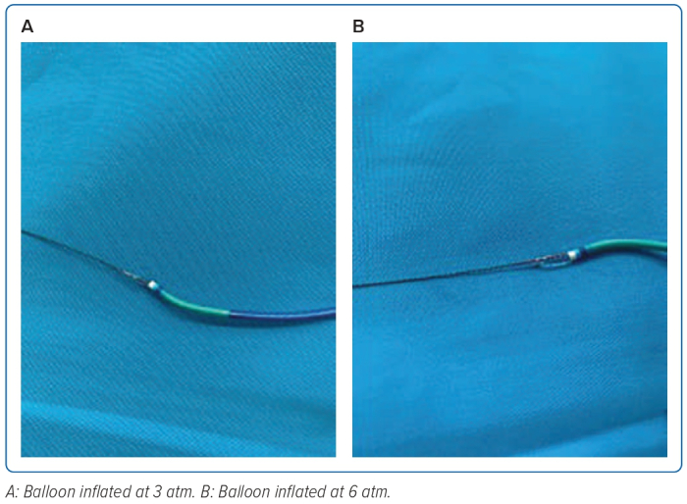
Safitri H, Aziz Alkatiri A, Firman D, Saleh Mangkuanom A, Iryuza N
Figure 8: Balloon-assisted Tracking Demonstration
Citation: Journal of Asian Pacific Society of Cardiology 2023;2:e28.
https://doi.org/10.15420/japsc.2022.29

