Slide 1
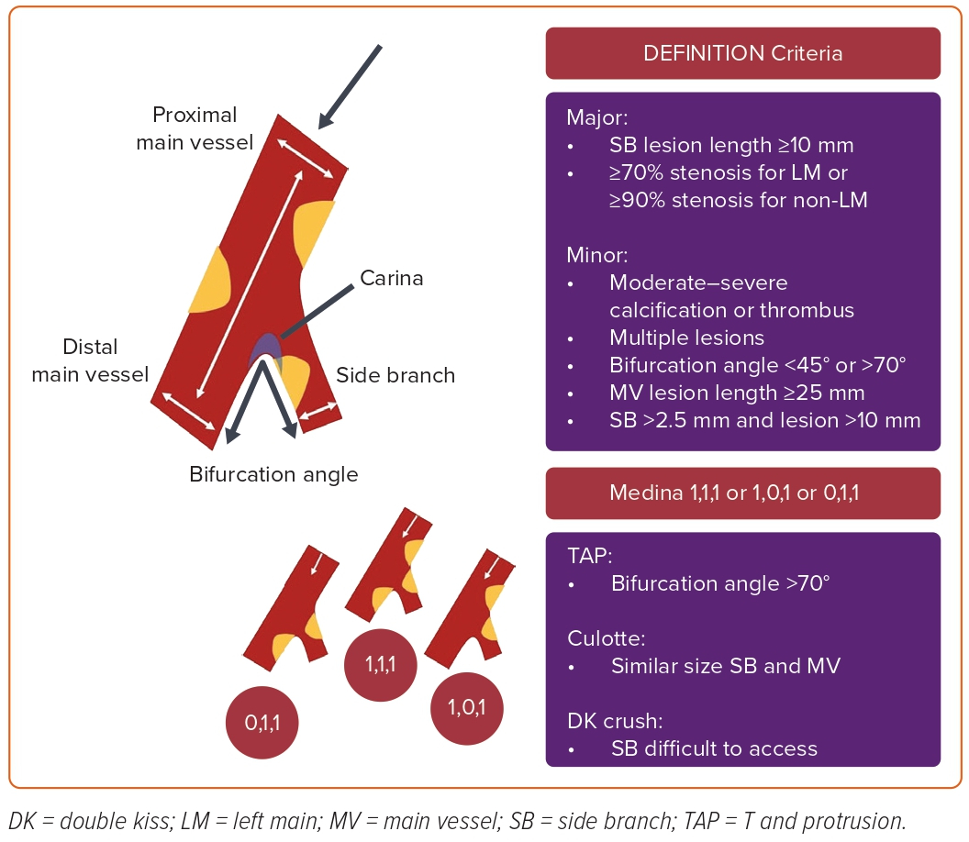
Nazmi Calik A, Cader FA, Rafflenbeul E, Okutucu S, Rahman Khan S, Polat Canbolat I, Yasar Sinan U, Alasnag M
Figure 1: Anatomical Definition and Classification of Coronary Bifurcations
Citation: US Cardiology Review 2023;17:e10.
https://doi.org/10.15420/usc.2022.25

