Slide 1
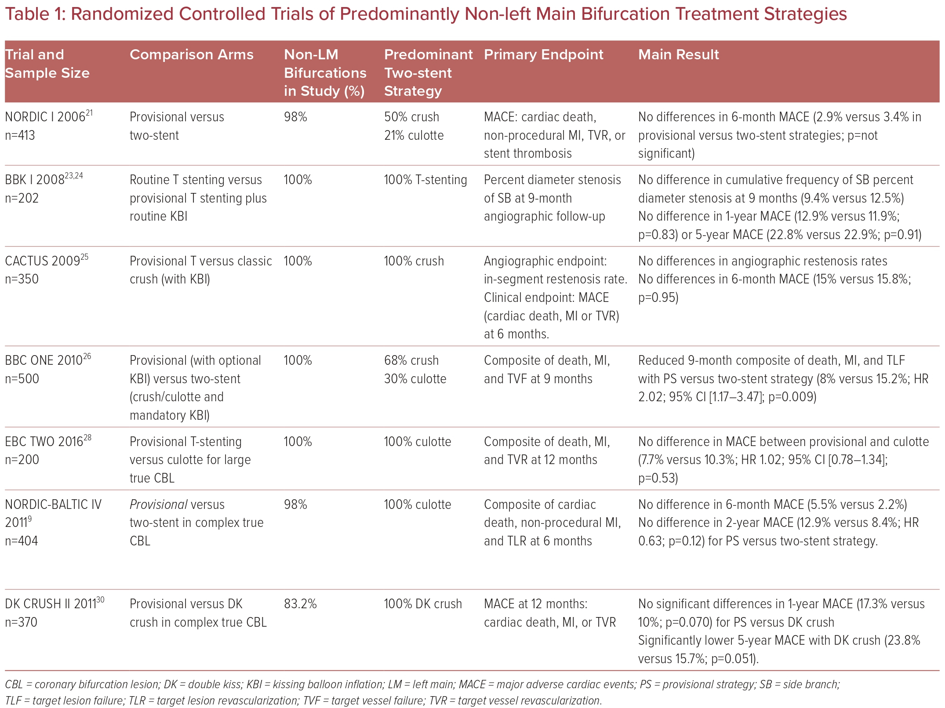
Nazmi Calik A, Cader FA, Rafflenbeul E, Okutucu S, Rahman Khan S, Polat Canbolat I, Yasar Sinan U, Alasnag M
Randomized Controlled Trials of Predominantly Non-left Main Bifurcation Treatment Strategies
Citation: US Cardiology Review 2023;17:e10.
https://doi.org/10.15420/usc.2022.25

