Slide 1
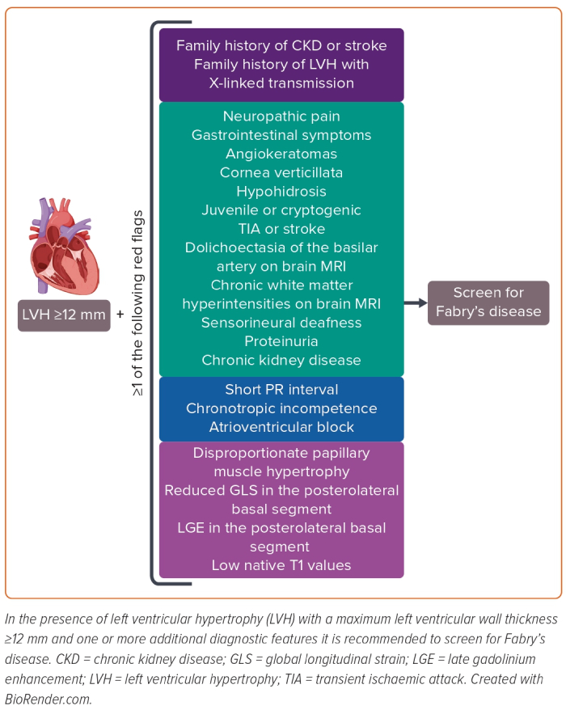
Monda E, Falco L, Palmiero G, Rubino M, Perna A, Diana G, Verrillo F, Dongiglio F, Cirillo A, Fusco A, Caiazza M, Limongelli G
Figure 1: When to Suspect and Screen for Fabry’s Disease
Citation: Cardiac Failure Review 2023;9:e12.
https://doi.org/10.15420/cfr.2023.06

