Slide 1
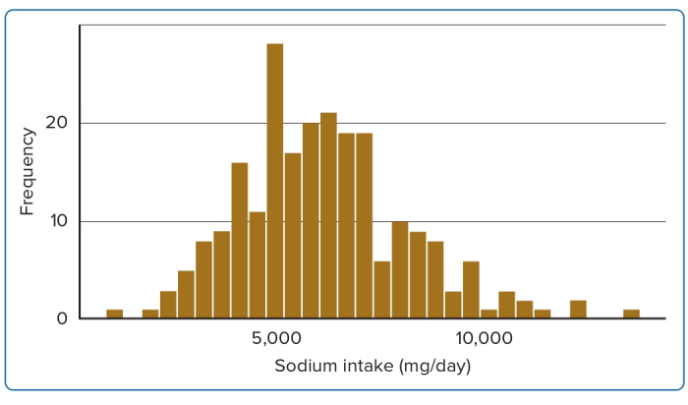
Amadoru H, Yasela De Silva R, Don Nandasiri Weerasinghe K, Gunaratne MDN, Koralage Buddhika Mahesh P, Prasangi Rupasinghe Siriwardena S, Malaka Gamage P, Mudalige Vishva Randhara Alles K, Thilini Randima Perera U, Anthonypillai R, Suriyaraachchi V, Rasika Nuwan Wijesiri K, Liyanage SN, Kokila Malwatta A, Liyanaarachchige Prasanna Jayasekara J, Jayatissa R, Deshapriya Kapuruge A
Figure 1: Distribution of Average Dietary Intake of Sodium (mg/day)
Citation: Journal of Asian Pacific Society of Cardiology 2023;2:e29.
https://doi.org/10.15420/japsc.2022.13

