Slide 1
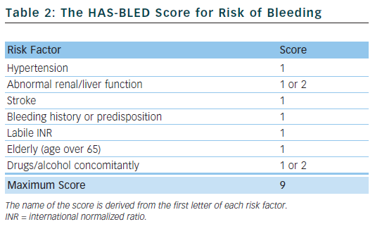
Ahmad Y, Lip GY
Table 2: The HAS-BLED Score for Risk of Bleeding
Citation: Arrhythmia & Electrophysiology Review 2012;1(1):12–6
https://doi.org/10.15420/aer.2012.1.12

