Slide 1
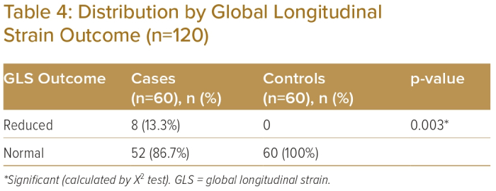
Shahidul Hoque M, Meshkat Ahmed C, Osmany DEMMF, Sowdagar MNH, Krishna Banerjee S
Distribution by Global Longitudinal Strain Outcome (n=120)
Citation: Journal of Asian Pacific Society of Cardiology 2023;2:e30.
https://doi.org/10.15420/japsc.2022.43

