Slide 1
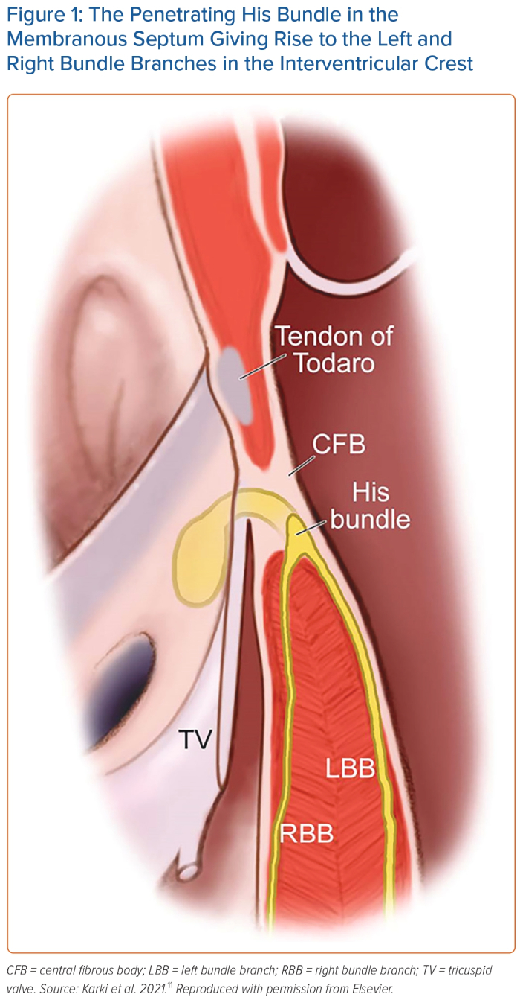
Ezzeddine FM, Leon IG, Cha YM
The Penetrating His Bundle in the Membranous Septum Giving Rise to the Left and Right Bundle Branches in the Interventricular Crest
Citation: Arrhythmia & Electrophysiology Review 2023;12:e22.
https://doi.org/10.15420/aer.2023.03

