Slide 1
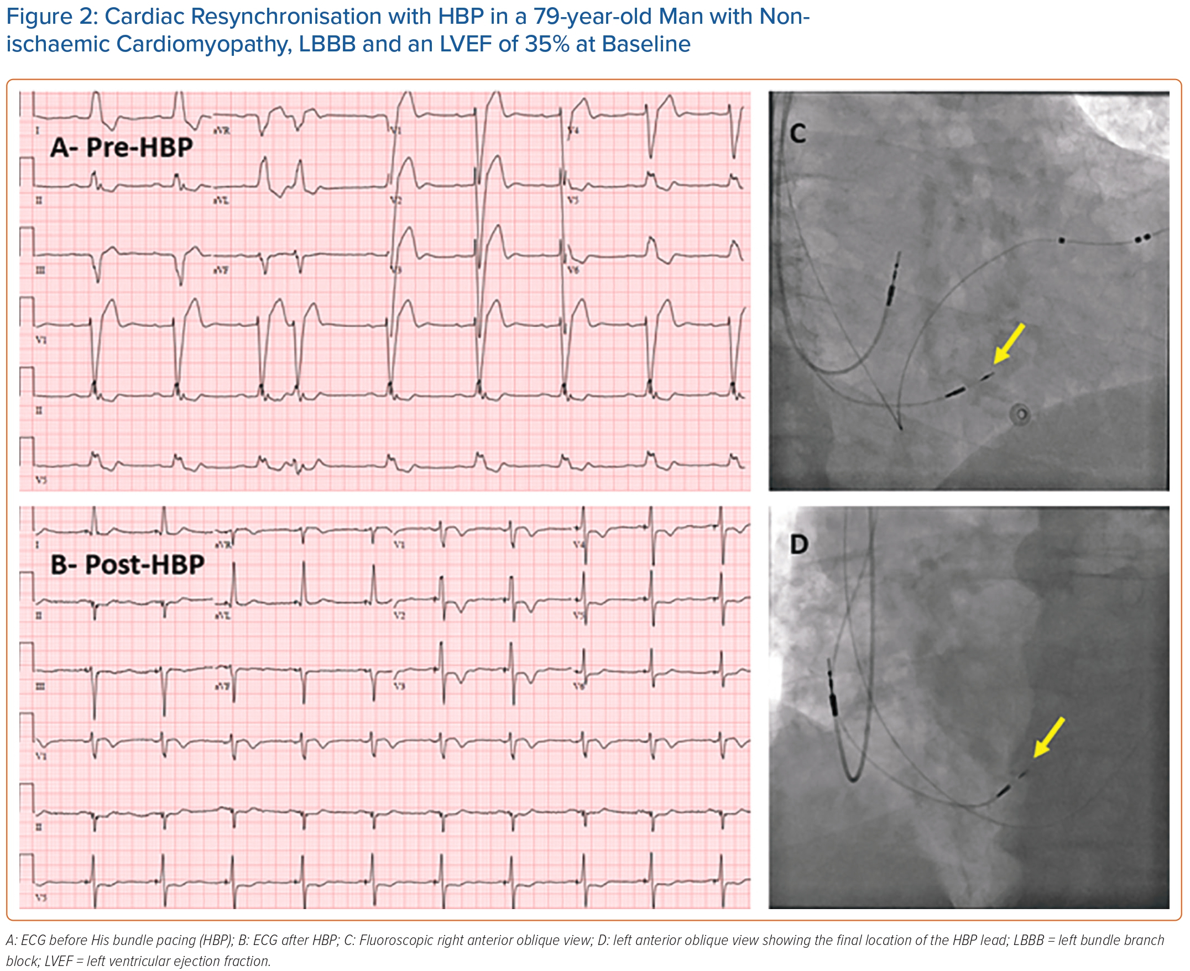
Ezzeddine FM, Leon IG, Cha YM
Cardiac Resynchronisation with HBP in a 79-year-old Man with Nonischaemic Cardiomyopathy, LBBB and an LVEF of 35% at Baseline
Citation: Arrhythmia & Electrophysiology Review 2023;12:e22.
https://doi.org/10.15420/aer.2023.03

