Slide 1
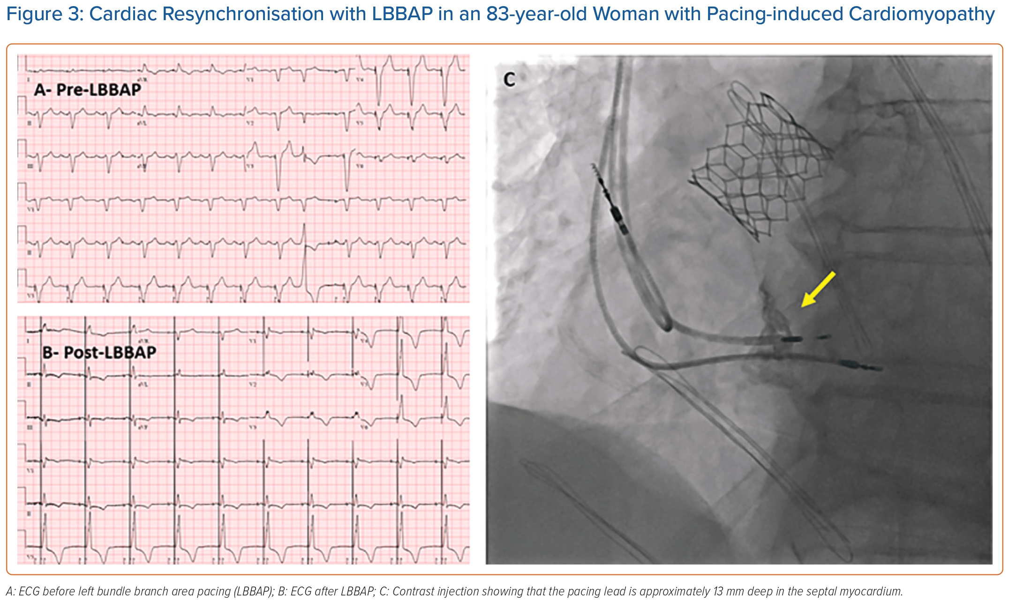
Ezzeddine FM, Leon IG, Cha YM
Cardiac Resynchronisation with LBBAP in an 83-year-old Woman with Pacing-induced Cardiomyopathy
Citation: Arrhythmia & Electrophysiology Review 2023;12:e22.
https://doi.org/10.15420/aer.2023.03

