Slide 1
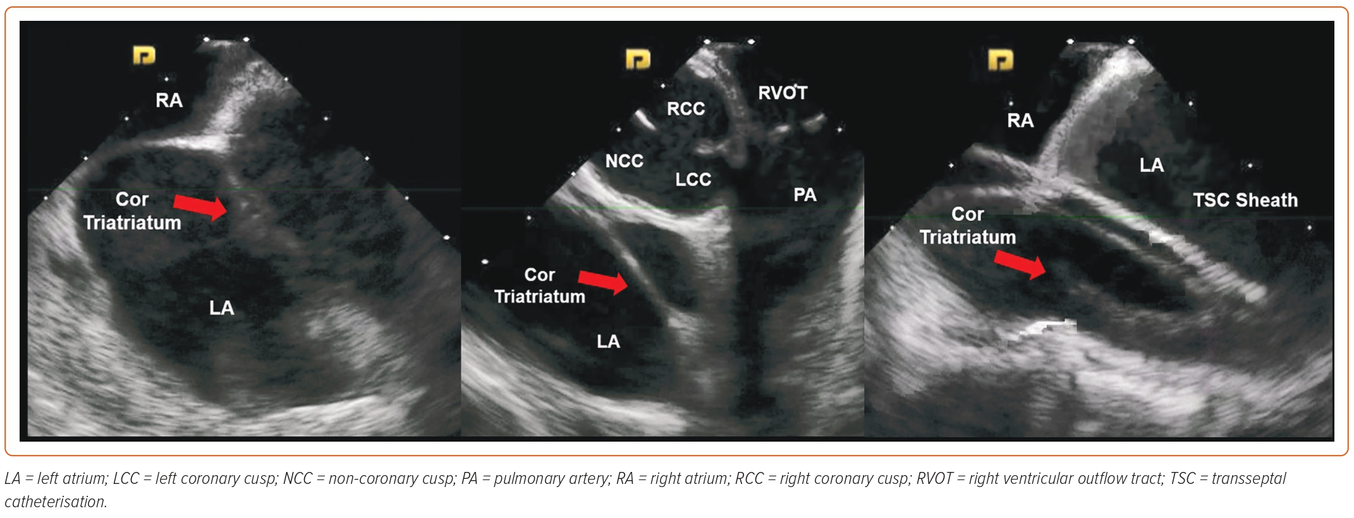
Mirwais M, Santangeli P
Figure 3: Transseptal Catheterisation for AF Ablation in a Patient with Cor Triatriatum
Citation: Arrhythmia & Electrophysiology Review 2023;12:e23.
https://doi.org/10.15420/aer.2022.25

