Slide 1
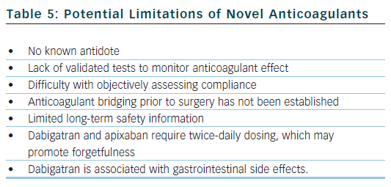
Ahmad Y, Lip GY
Potential Limitations of Novel Anticoagulants
Citation: Arrhythmia & Electrophysiology Review 2012;1(1):12–6
https://doi.org/10.15420/aer.2012.1.12

