Slide 1
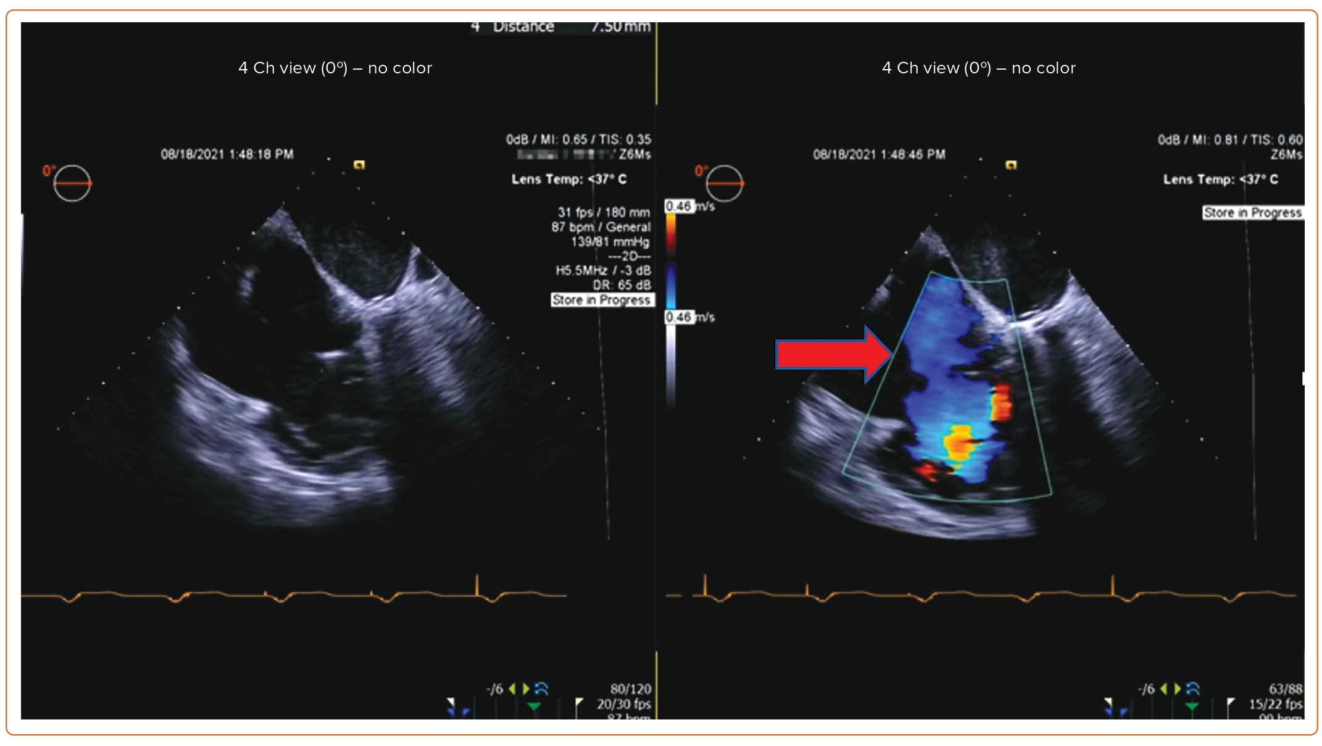
Asim Shabbir M, Yadav P, Tiwari N, Velagapudi P
Figure 2: Mid Esophageal View of Transesophageal Echocardiogram Showing Severe Tricuspid Regurgitation
Citation: US Cardiology Review 2023;17:e11.
https://doi.org/10.15420/usc.2023.07

