Slide 1
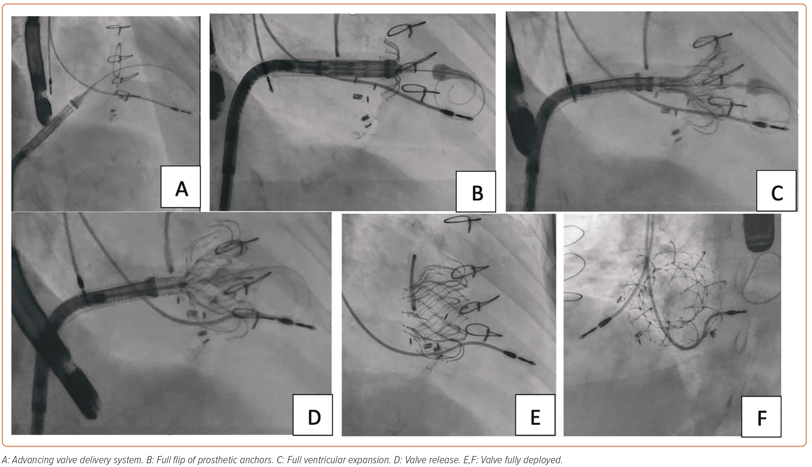
Asim Shabbir M, Yadav P, Tiwari N, Velagapudi P
Figure 4: Intraprocedural Fluoroscopy Images
Citation: US Cardiology Review 2023;17:e11.
https://doi.org/10.15420/usc.2023.07

