Slide 1
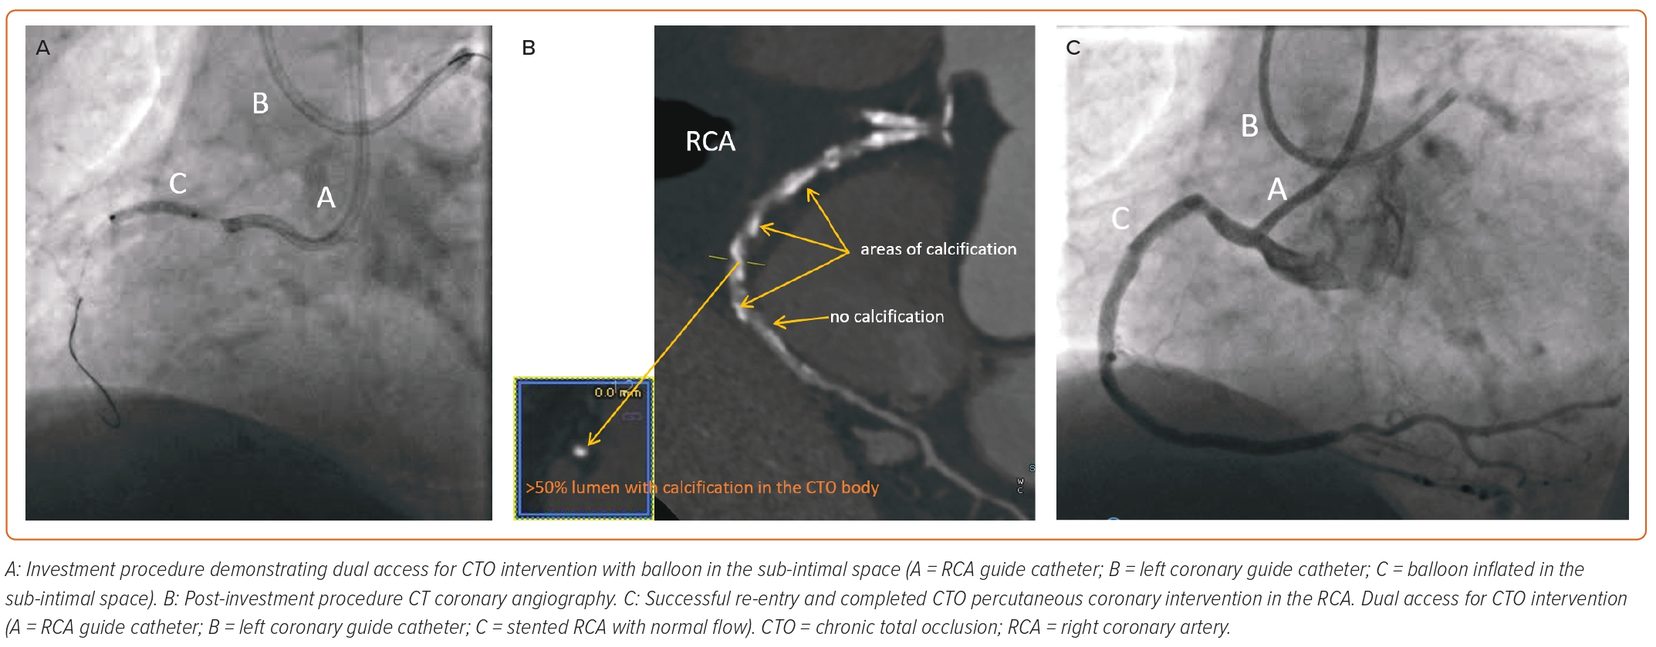
Yassin F, Khan J, Mozid A, Connolly D, Sharma V
Figure 2: CT Coronary Angiography After Investment Procedure Facilitates Successful Stenting
Citation: European Cardiology Review 2023;18:e48.
https://doi.org/10.15420/ecr.2022.61

