Slide 1
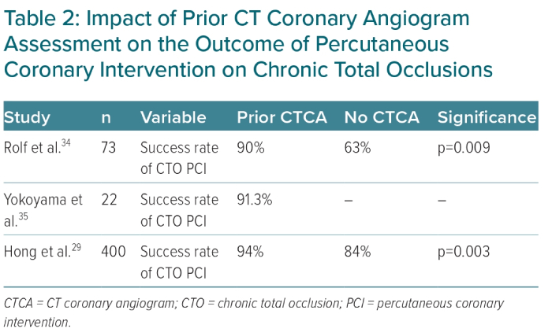
Yassin F, Khan J, Mozid A, Connolly D, Sharma V
Impact of Prior CT Coronary Angiogram Assessment on the Outcome of Percutaneous Coronary Intervention on Chronic Total Occlusions
Citation: European Cardiology Review 2023;18:e48.
https://doi.org/10.15420/ecr.2022.61

